Slide 1
Chapter 5 Plate Tectonics: A Scientific Theory Unfolds

Slide 4
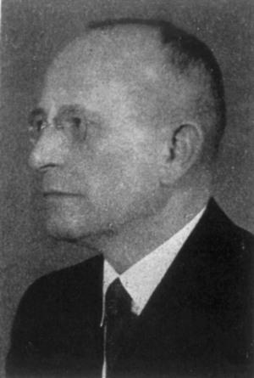
Continental Drift: An Idea Before Its Time
Alfred Wegener
First proposed his continental drift hypothesis in 1915
Published The Origin of Continents and Oceans
Continental drift hypothesis
Supercontinent called Pangaea began breaking apart about 200 million years ago

Slide 5
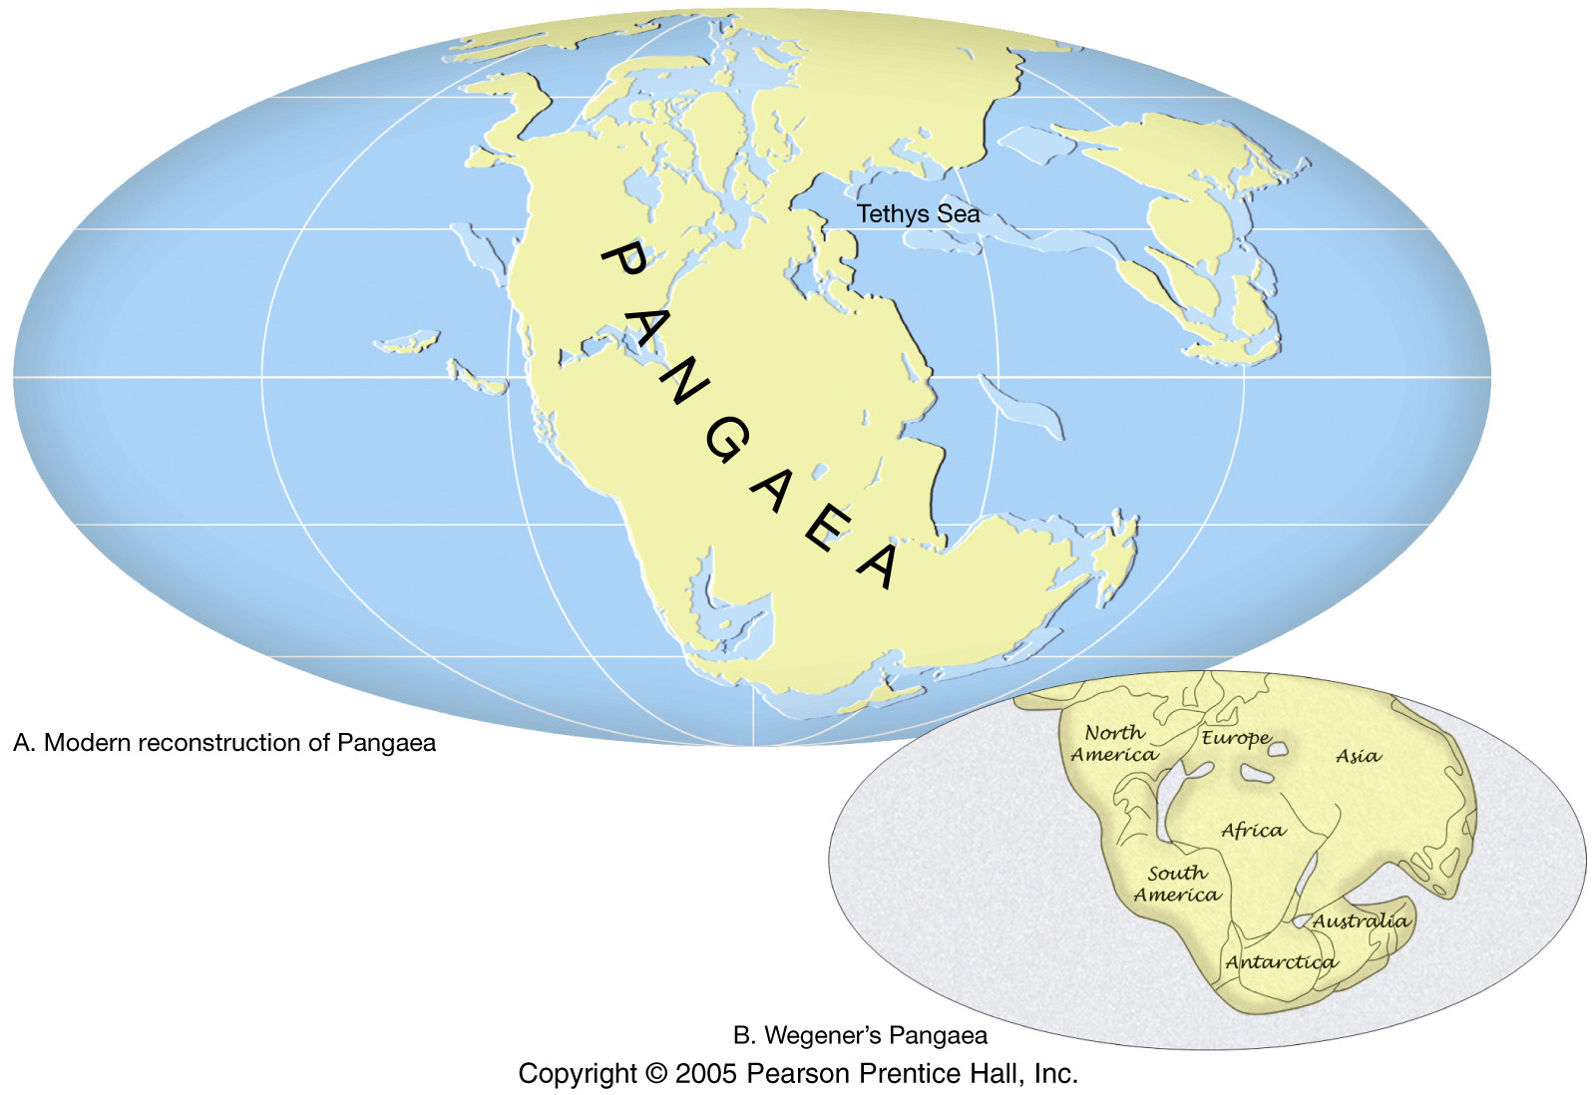
Pangaea Approximately 200 Million Years Ago

Slide 6
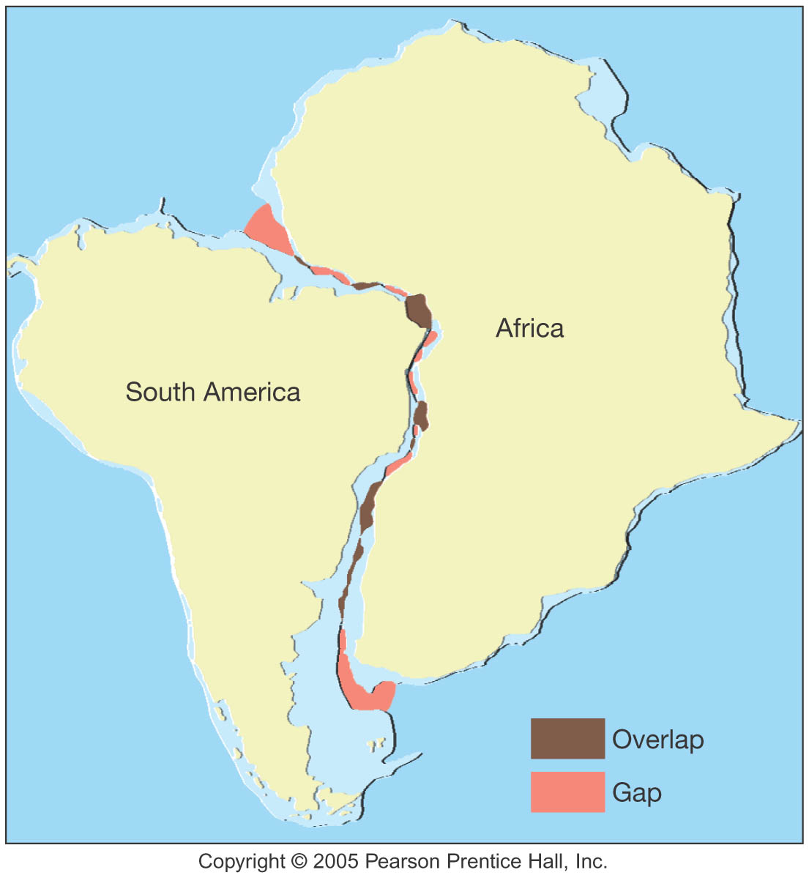
Fit of Continents

Slide 7
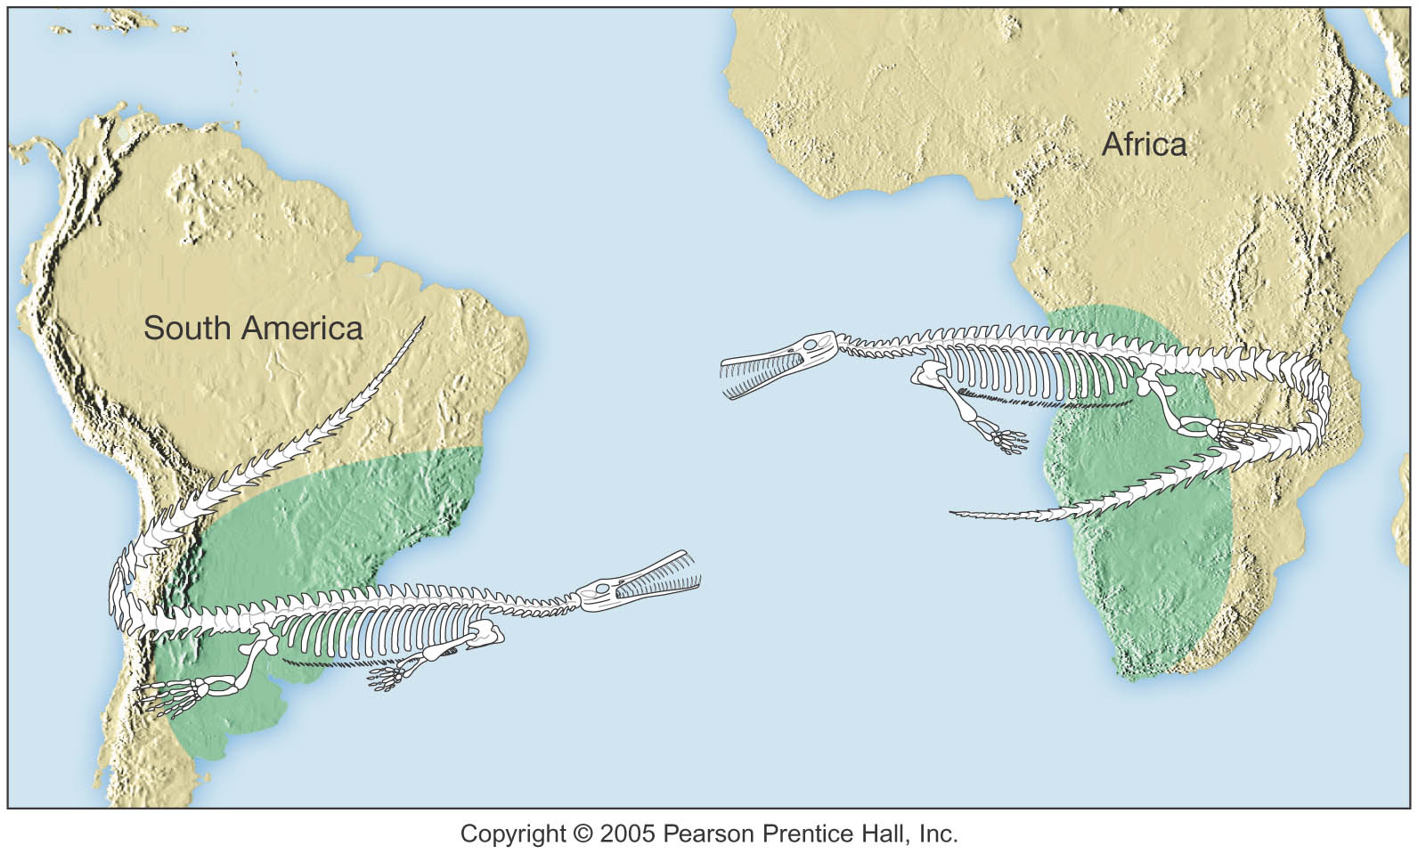
Similar Fossils on Different Continents

Slide 8
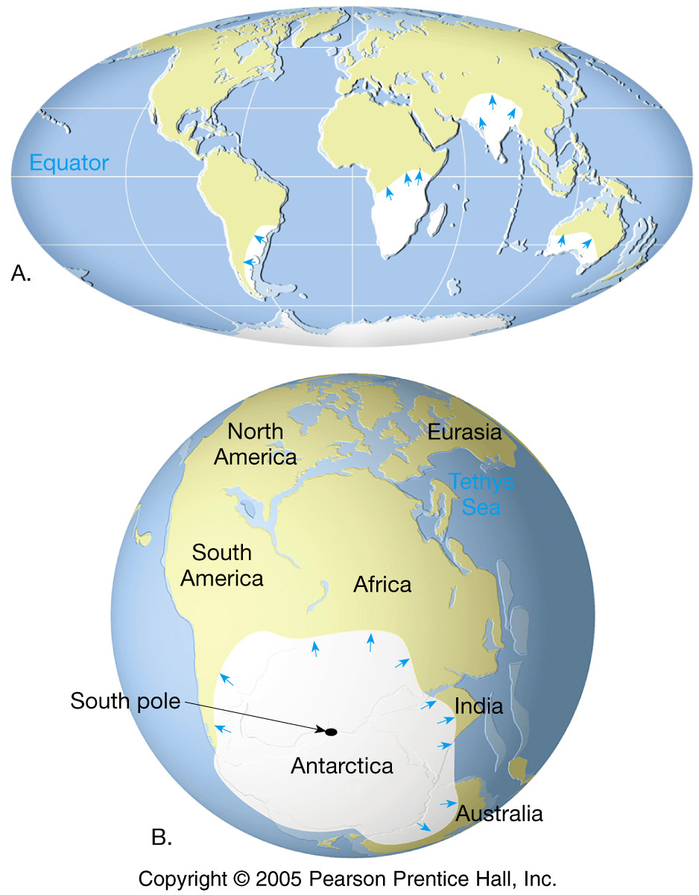
Paleoclimatic
Evidence
Glaciers

Slide 9
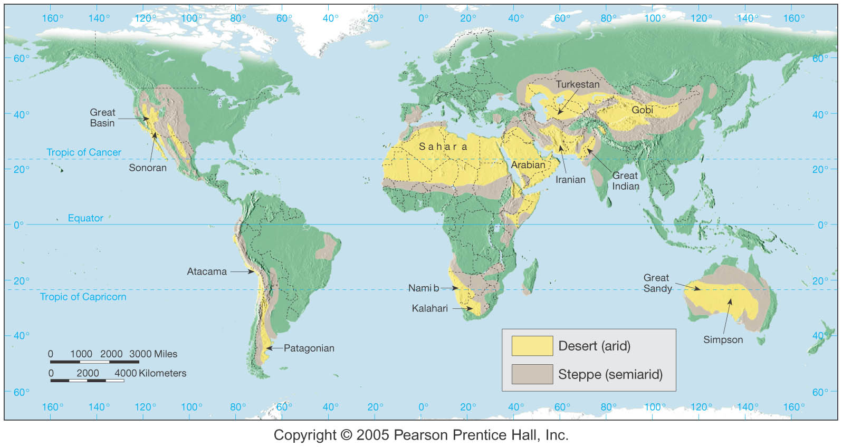
Paleoclimatic Evidence
Other Evidence: Coal Beds, Deserts, Coral

Slide 10
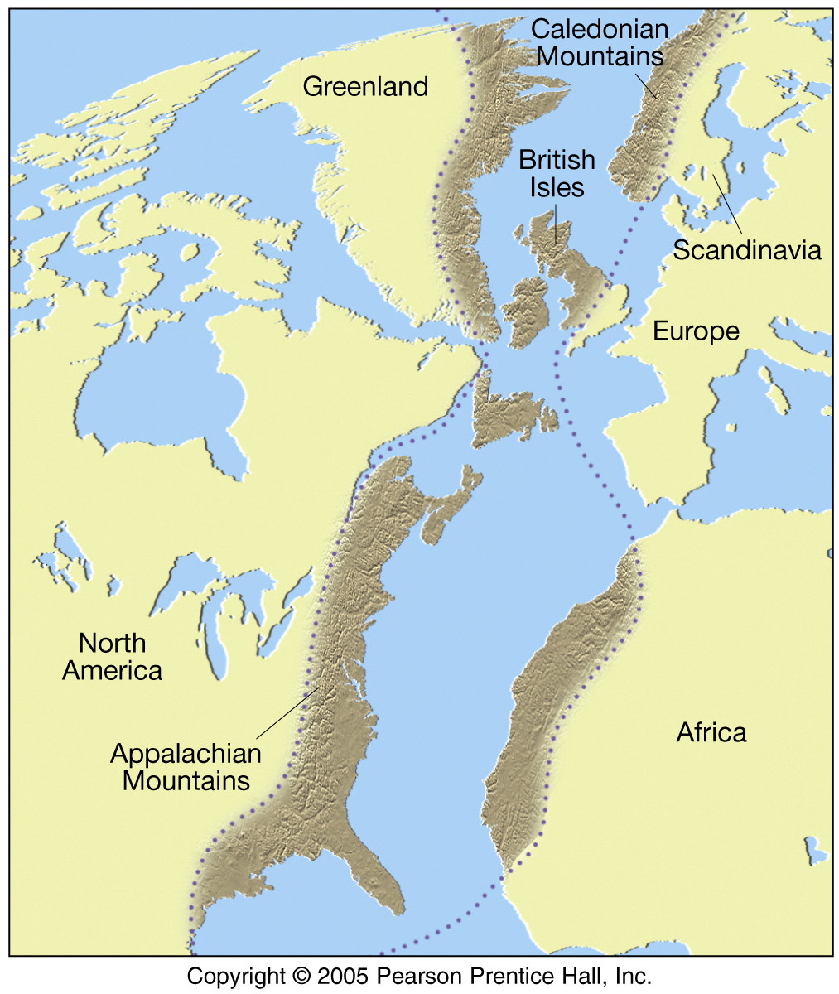
Matching
Mountain
Ranges

Slide 11
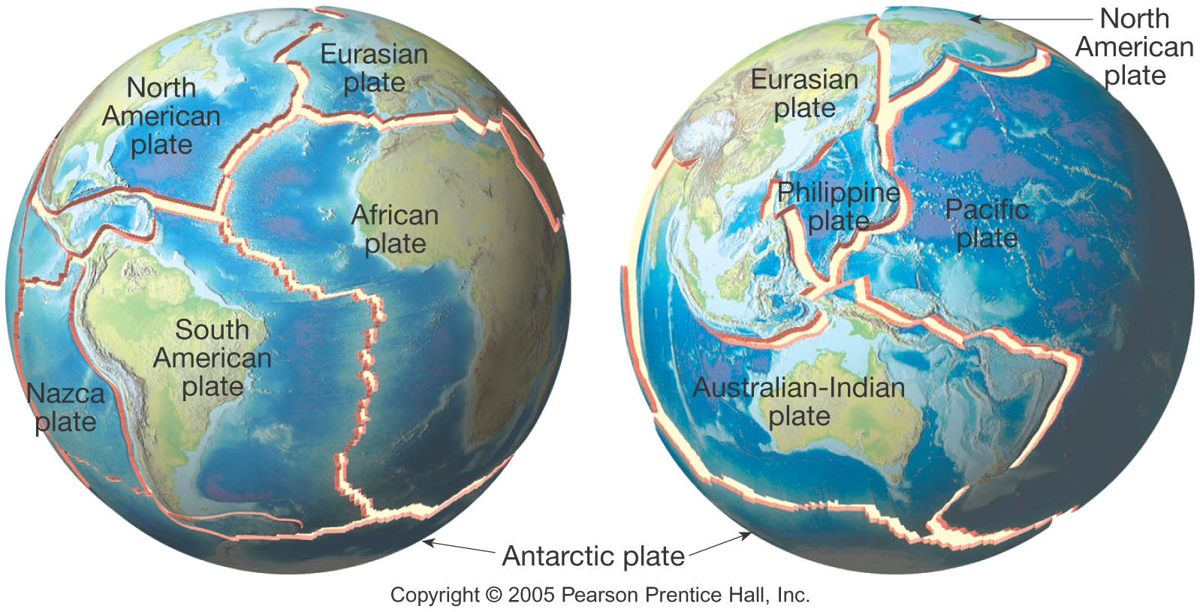
Plate Tectonics - Review

Slide 12
Plate Tectonics: 3 Types of Plate Boundaries
1) Divergent plate boundaries (constructive margins)
2) Convergent plate boundaries (destructive margins)
3) Transform fault boundaries (conservative margins)

Slide 13
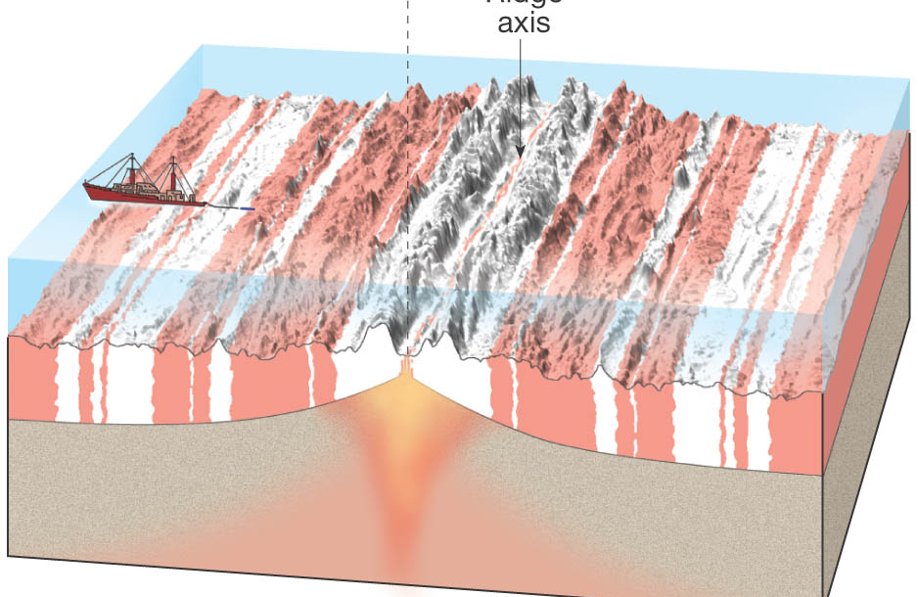
Testing the Plate Tectonics Model
Geomagnetic reversals are symmetrically recorded in the seafloor

Slide 14
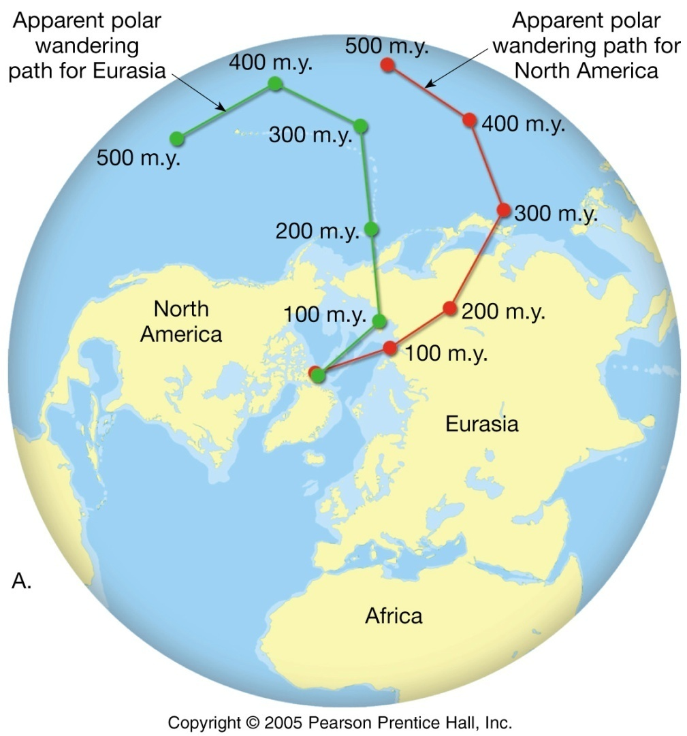
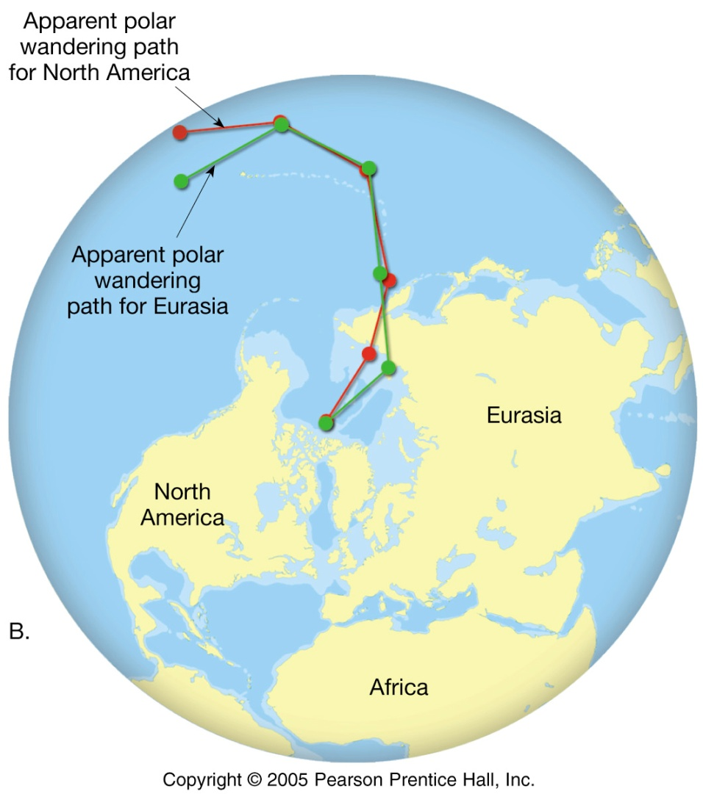
Polar-Wandering Paths for Eurasia and North America
Figure 5.21

Slide 15
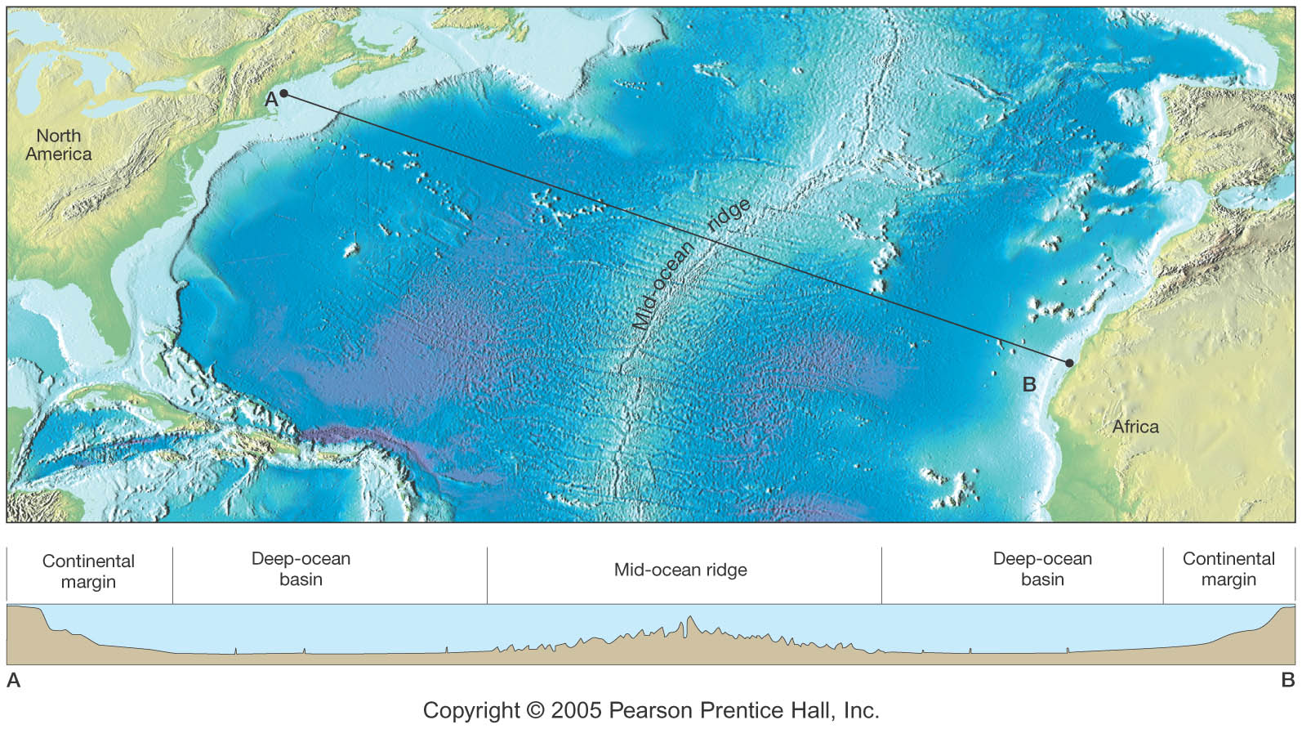
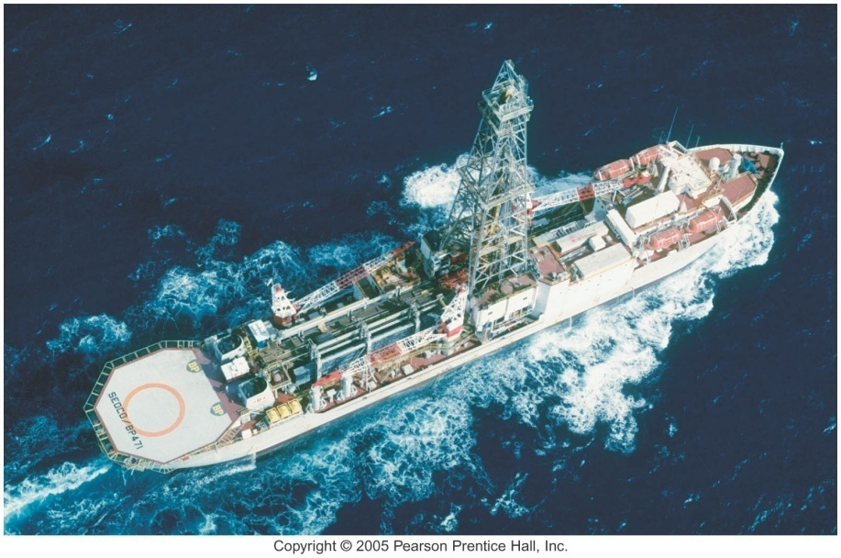
Testing the Plate Tectonics Model
Evidence from ocean drilling
Some of the most convincing evidence confirming seafloor spreading has come from drilling directly into ocean-floor sediment
Age of deepest sediments
Thickness of ocean-floor sediments verifies seafloor spreading

Slide 16
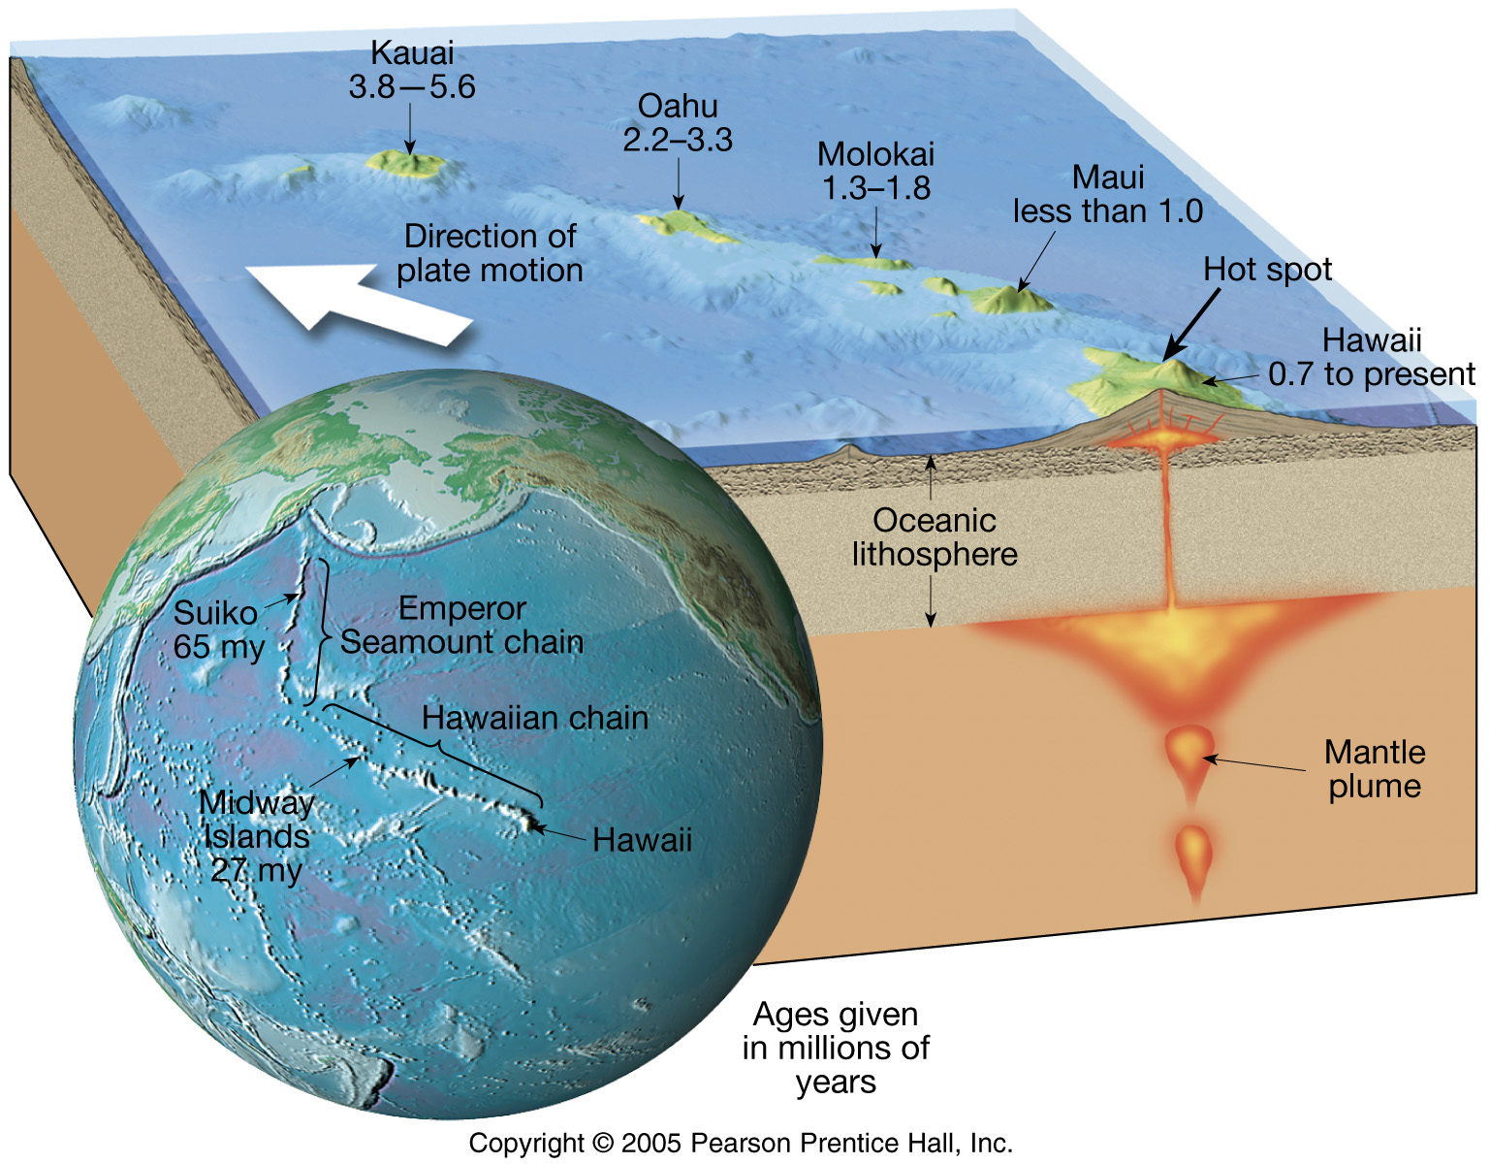
The Hawaiian Islands
Figure 5.19

Slide 17
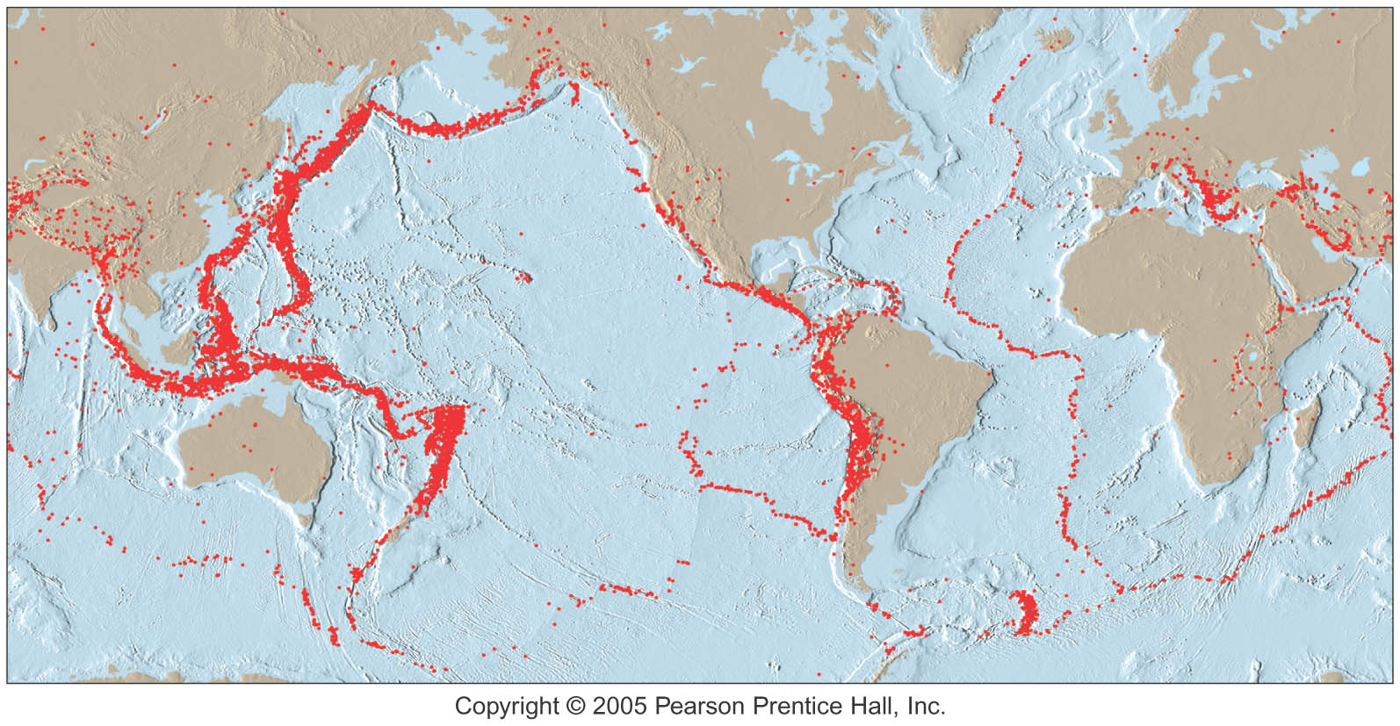
Testing the Plate Tectonics Model
Earth Quake Patterns

Slide 18
Chapter 6 Restless Earth: Earthquakes, Geologic Structures, and Mountain Building

Slide 19
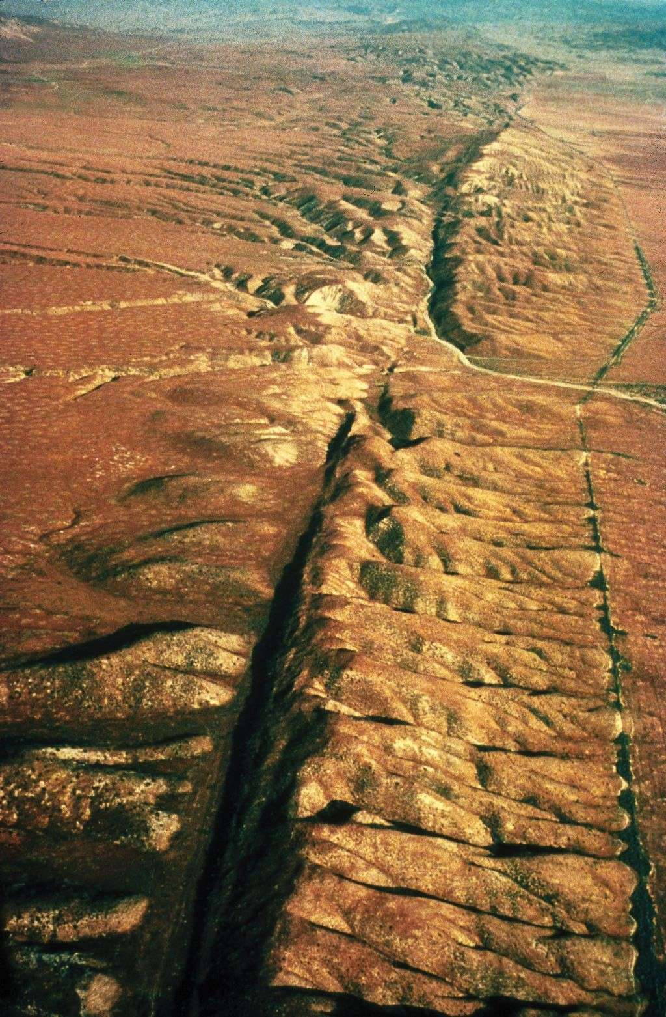
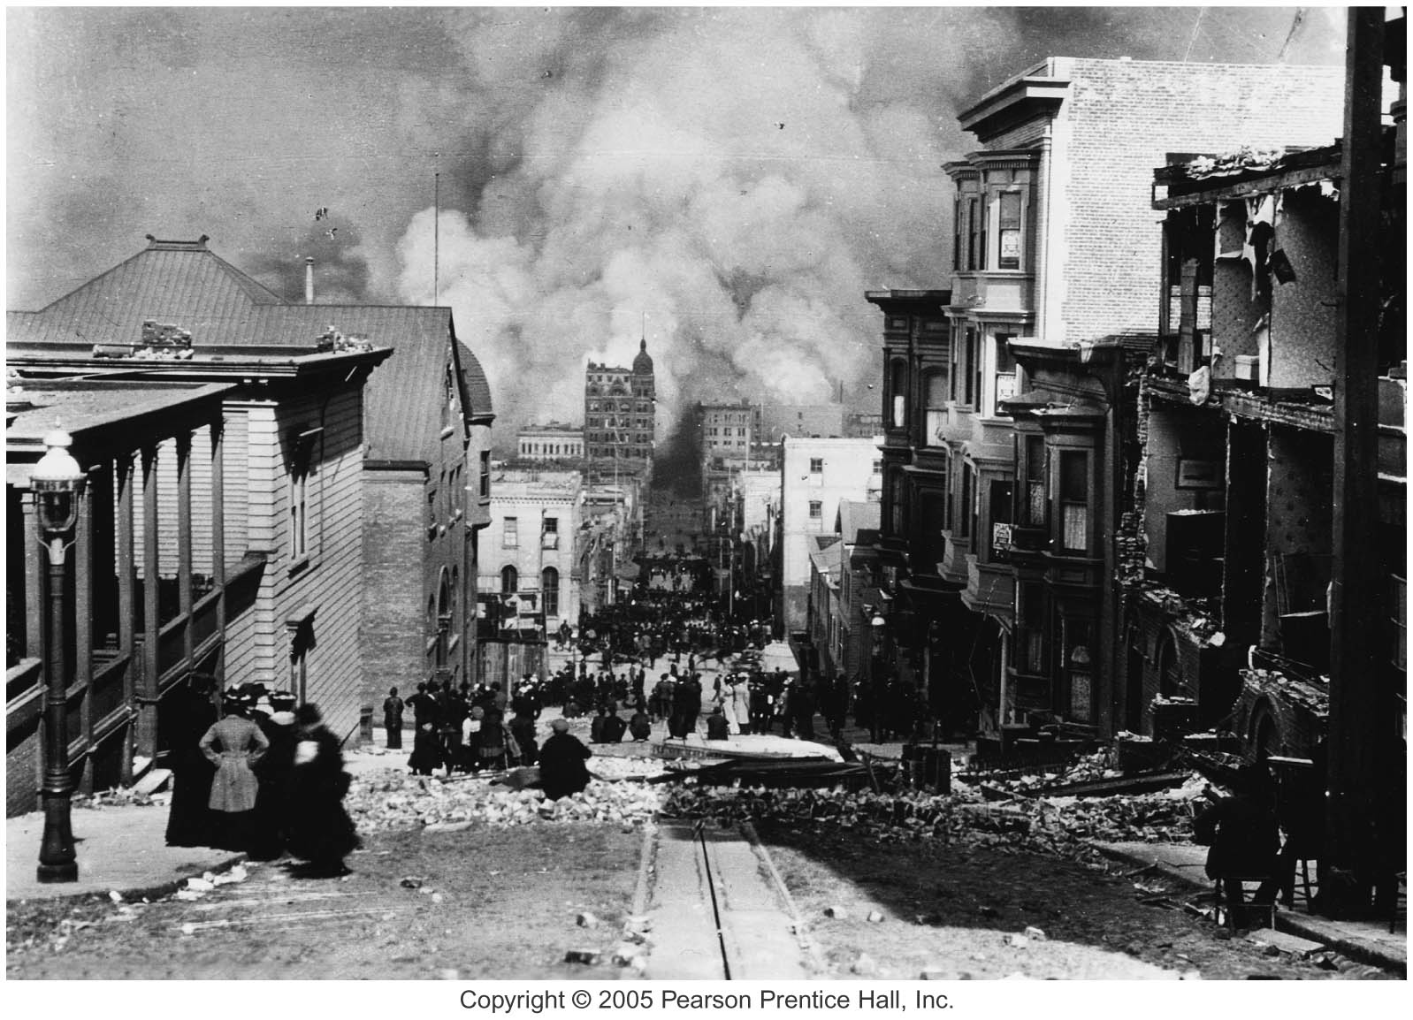
What Is an Earthquake?
An earthquake is the vibration of Earth produced by the rapid release of energy

Slide 20
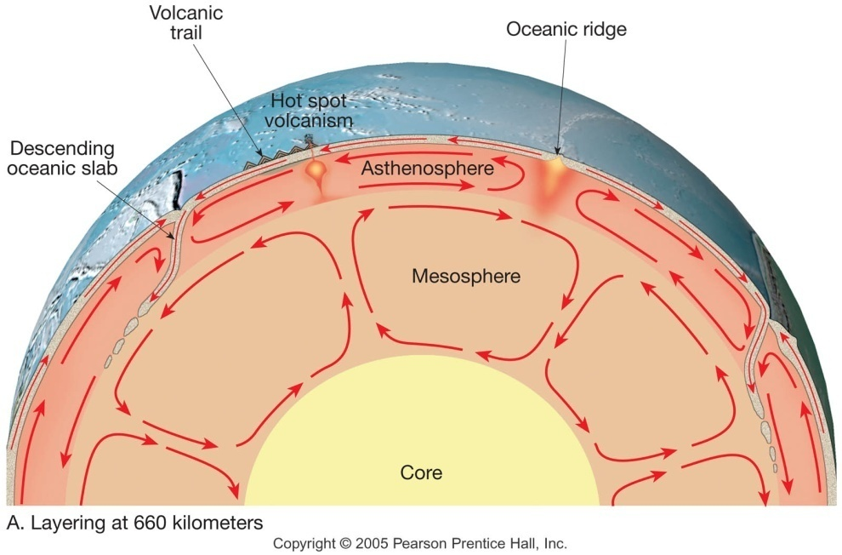
What Is an Earthquake?
Earthquakes and faults
Movements that produce earthquakes are usually associated with large fractures in Earth’s crust called faults
Most of the motion along faults can be explained by the plate tectonics theory

Slide 21
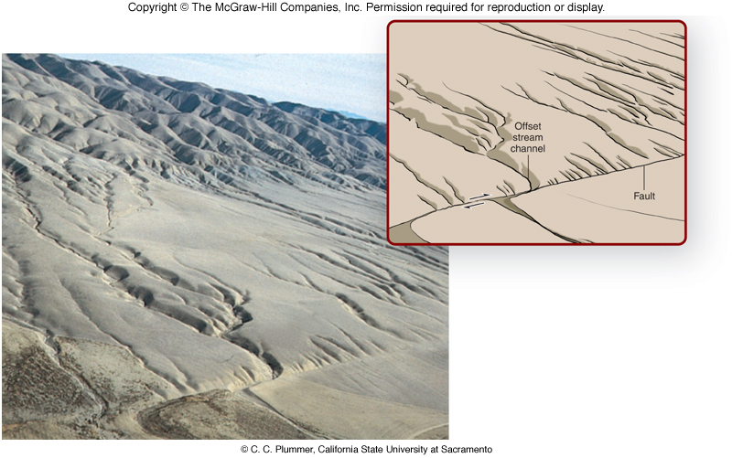
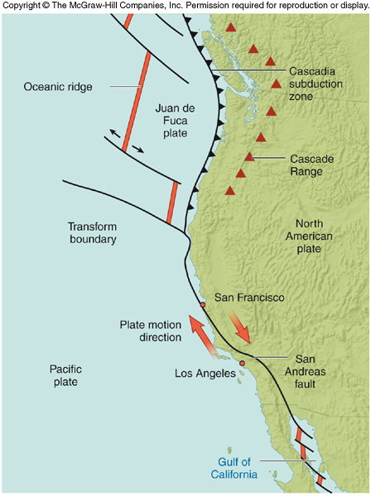
Faults, Earthquakes, and Plate Tectonics
San Andreas fault, California, forms part of the boundary between the North American and Pacific plates
Stream channels offset by recent movements on the fault
The Good Earth/Chapter 5: Earthquakes

Slide 22
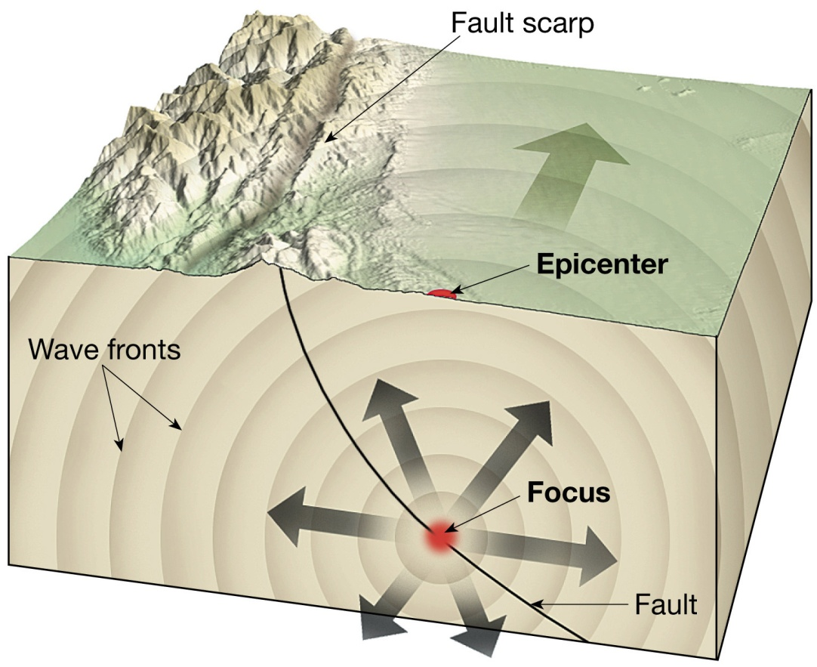
What Is an Earthquake?
Energy released radiates in all directions from its source, the focus
Energy is in the form of waves

Slide 23
Earthquakes per year
600,000
300,000
49,000
6,200
800
266
18
2
956,286/ year
2,620/day
109 / hour
2/ minute

Slide 24
Seismology
The study of earthquake waves, seismology, dates back almost 2000 years to the Chinese
Seismographs, instruments that record seismic waves
Record the movement of Earth in relation to a stationary mass on a rotating drum or magnetic tape

Slide 25
Seismology
Seismographs
More than one type of seismograph is needed to record both vertical and horizontal ground motion

Slide 26
Seismographs
Notes:
To view this animation, click “View” and then “Slide Show” on the top navigation bar.

Slide 27
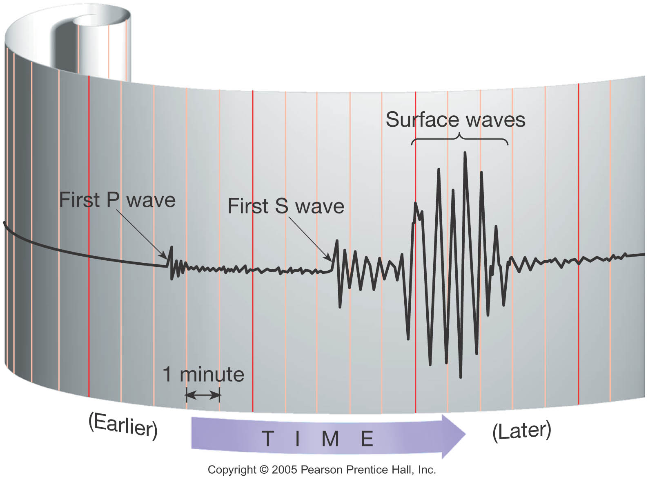
Seismology
Seismographs
Records obtained are called seismograms

Slide 28
Seismologists

Slide 29
What Is an earthquake?
Foreshocks and aftershocks
Adjustments that follow a major earthquake often generate smaller earthquakes called aftershocks
Small earthquakes, called foreshocks, often precede a major earthquake by days or, in some cases, by as much as several years

Slide 30
What Is an earthquake?
Elastic rebound
Mechanism for earthquakes was first explained by H. F. Reid
Rocks on both sides of an existing fault are deformed by tectonic forces
Rocks bend and store elastic energy
Frictional resistance holding the rocks together is overcome

Slide 31
What Is an earthquake?
Elastic rebound
Earthquake mechanism
Slippage at the weakest point (the focus) occurs
Vibrations (earthquakes) occur as the deformed rock “springs back” to its original shape (elastic rebound)

Slide 32
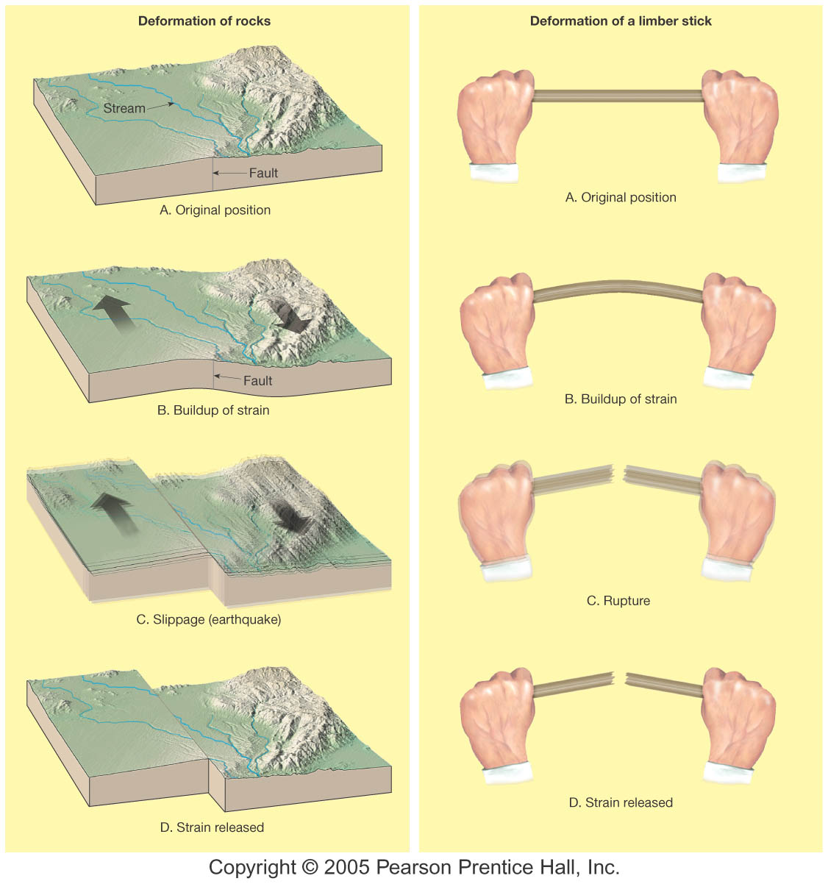
What Is an earthquake?
Elastic Rebound

Slide 33
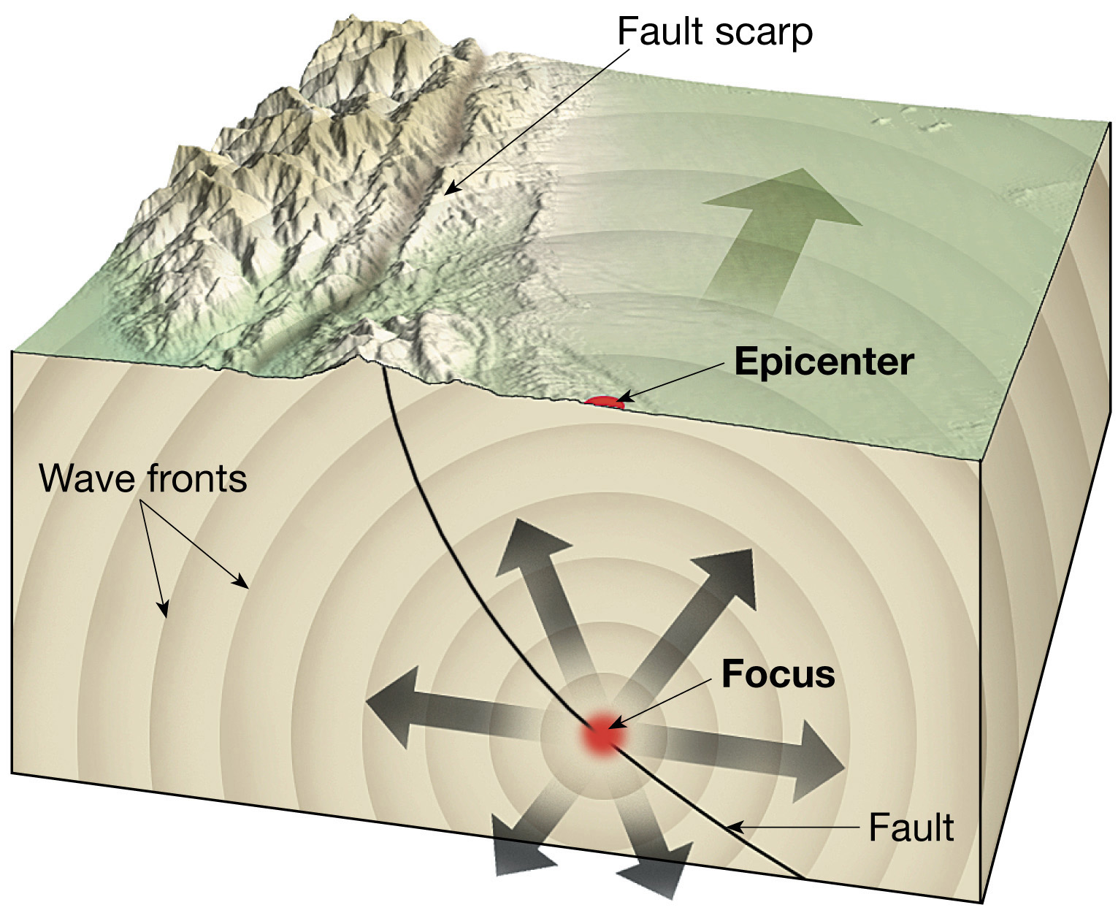
Earthquake Focus and Epicenter
Figure 6.2

Slide 34
Locations and Distributions

Slide 35
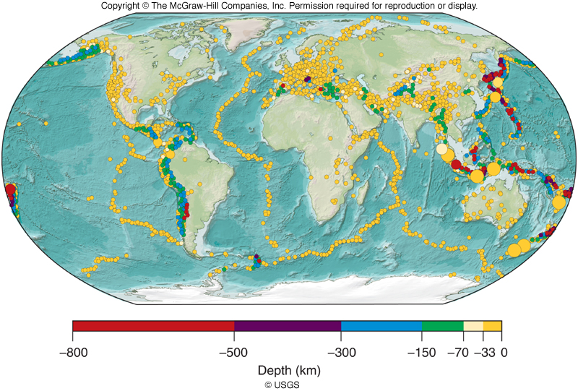
Where to expect Earthquakes
World Distribution of Earthquakes
Most earthquakes occur along plate boundaries, relatively few in interiors of plates
Shallow earthquakes much more common than deep events
Divergent plate boundaries (oceanic ridges) characterized by earthquakes with shallow focal depths (0-33 km)
The Good Earth/Chapter 5: Earthquakes

Slide 36
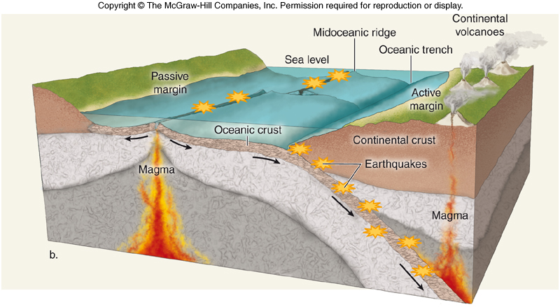
Where to expect Earthquakes
World Distribution of Earthquakes
Largest earthquakes found in association with convergent plate boundaries
Convergent plate boundaries (oceanic trenches) characterized by earthquakes with a range of focal depths (0-800 km)
The Good Earth/Chapter 5: Earthquakes

Slide 37
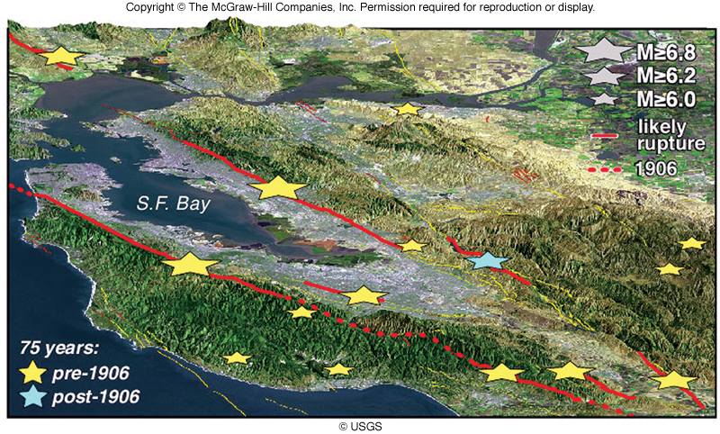
Where to expect Earthquakes
US Earthquakes
Largest, most frequent, US earthquakes along convergent plate boundary south of Alaska
Most US earthquake damage occurs in populous California
62% chance of a large earthquake in San Francisco Bay area by 2032
The Good Earth/Chapter 5: Earthquakes

Slide 38
Haiti

Slide 39
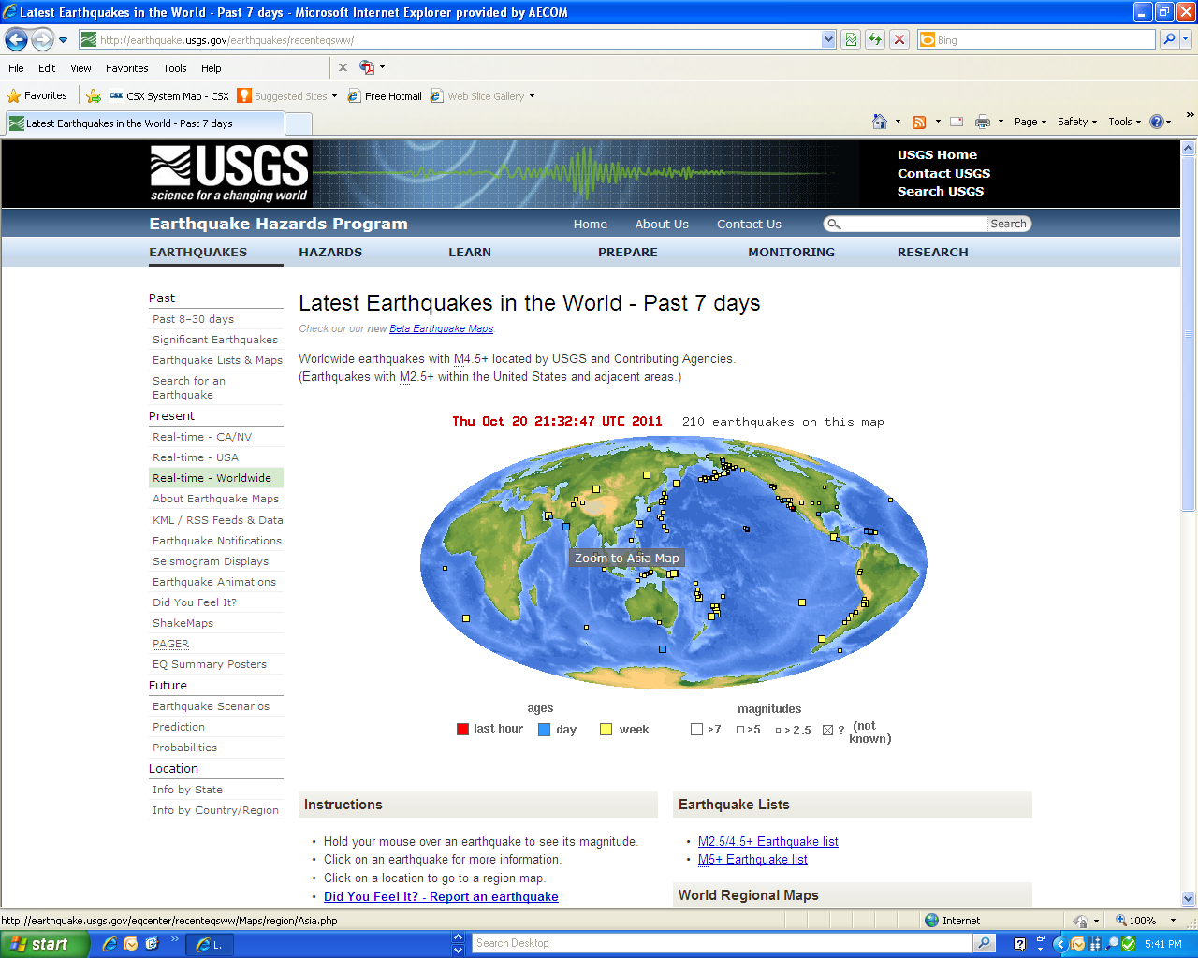

Slide 40
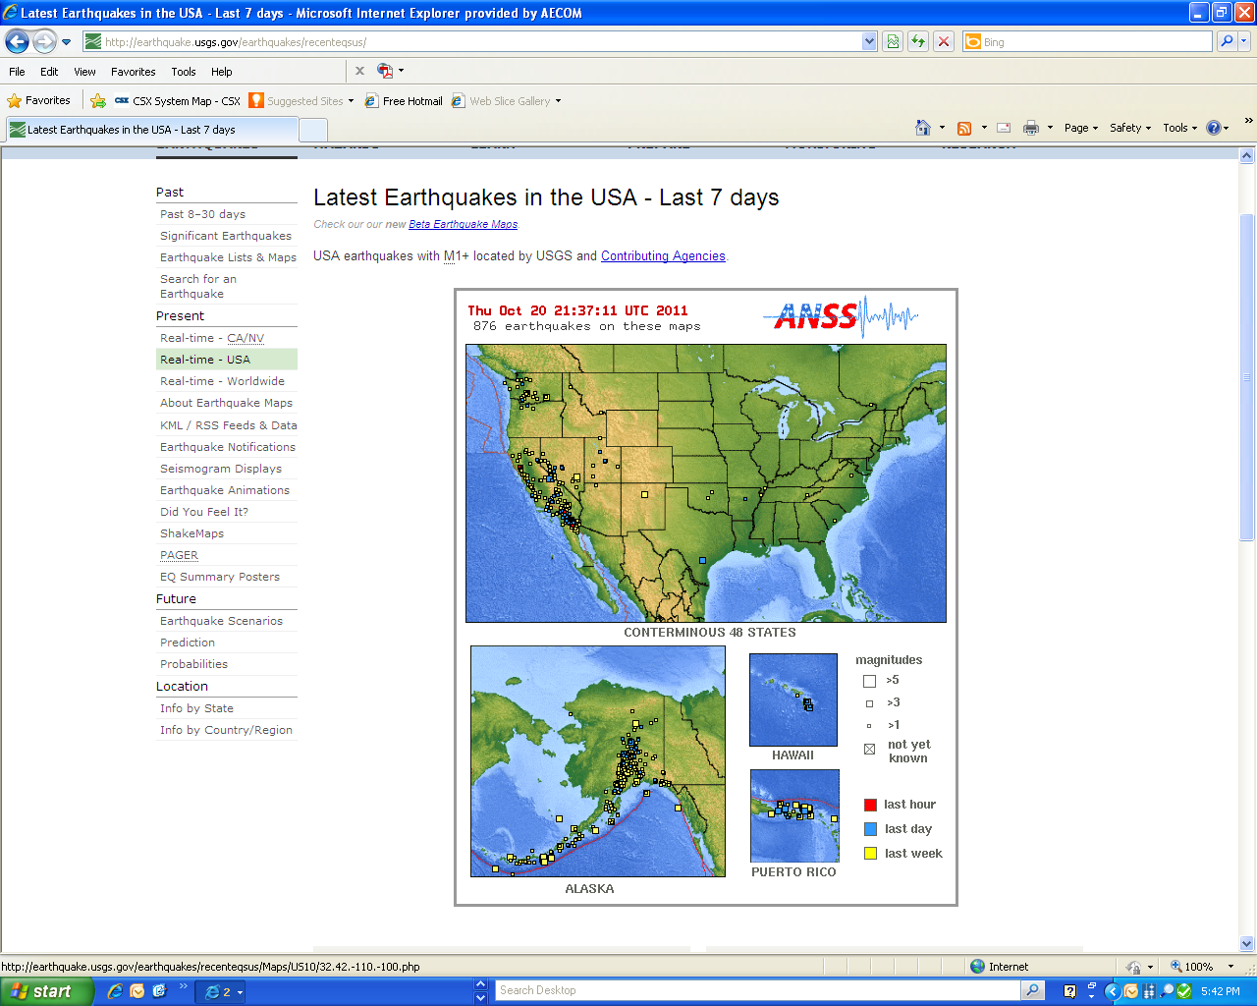

Slide 41
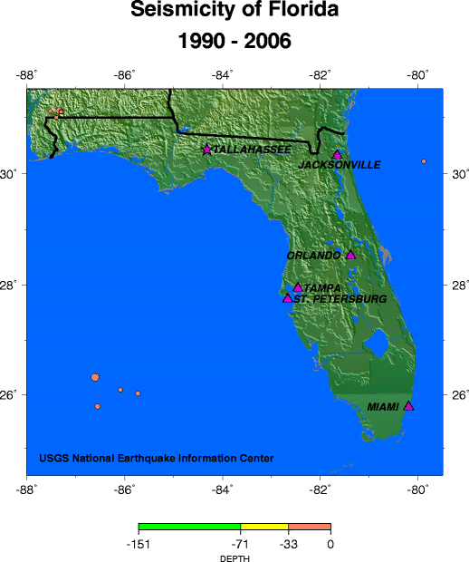
Locations and Distributions

Slide 42
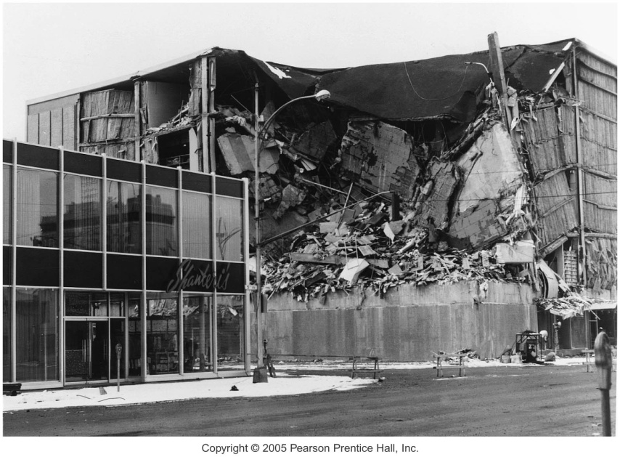
Earthquake Waves
Types of seismic waves
Body Waves (P and S Waves)
Travel within the Earth
Surface waves
Travel along outer part of Earth

Slide 43
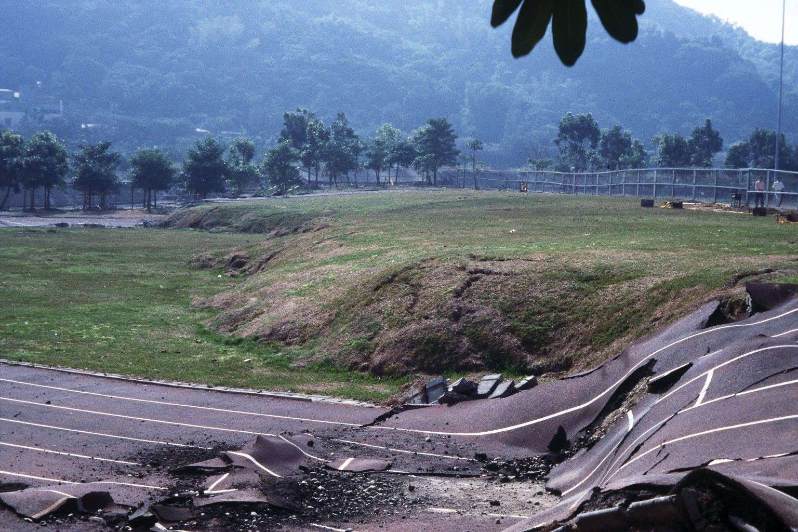
Seismology
Types of seismic waves
Surface waves
Complex motion
Cause greatest destruction
Exhibit greatest amplitude and slowest velocity

Slide 44
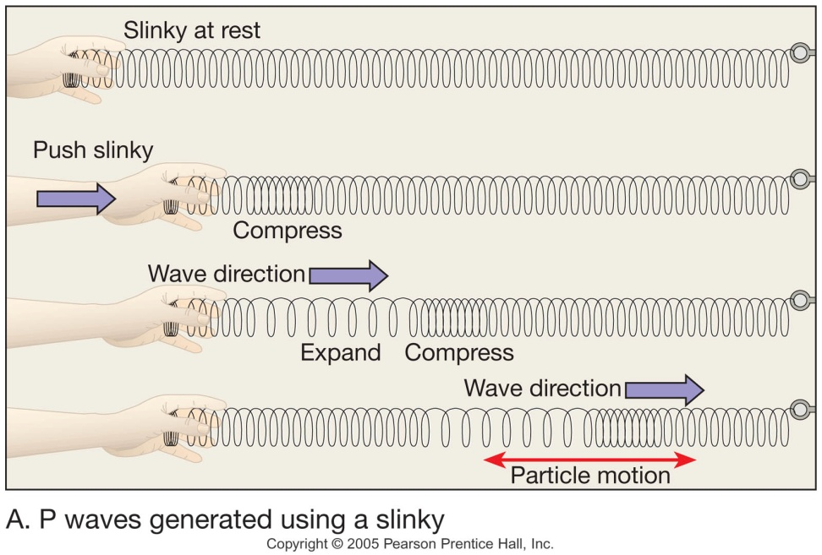
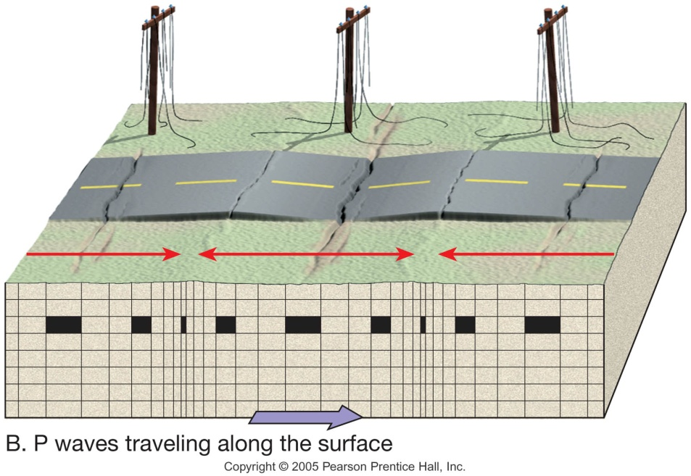
Seismology
Primary (P) waves
Travel through Earth’s interior
Push-pull (compress and expand) motion, changing the volume of the intervening material
Fastest Waves
Travel through solids, liquids, and gases

Slide 45
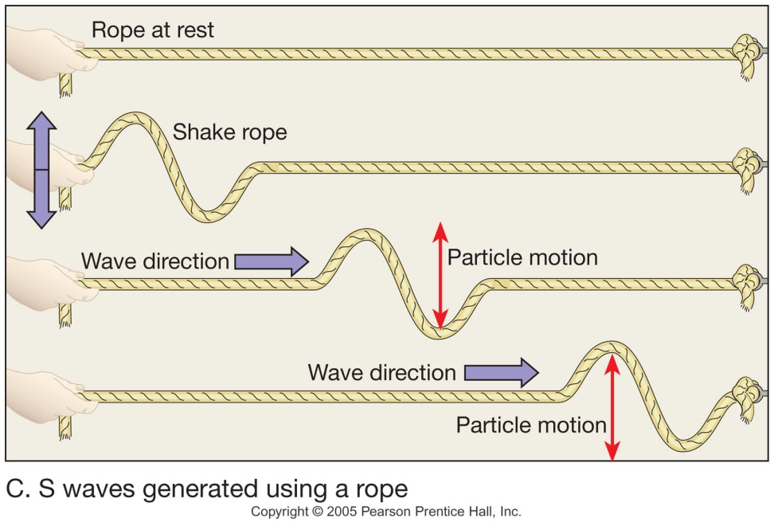
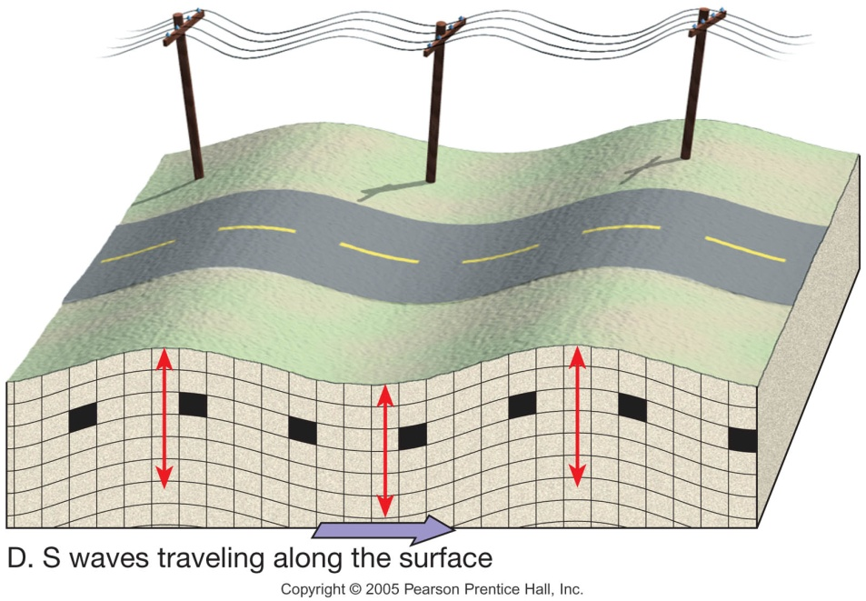
Seismology
Secondary (S) waves
“Shake” motion at right angles to their direction of travel
Travel only through solids
Slower velocity than P waves

Slide 46
Earthquake Waves
Notes:
To view this animation, click “View” and then “Slide Show” on the top navigation bar.

Slide 47
Locating an Earthquake
Terms
Focus—The place within Earth where earthquake waves originate
Epicenter —Location on the surface directly above the focus
Epicenter is located using the difference in velocities of P and S waves

Slide 48
Seismic Waves and Earthquake Detection
Seismic waves – vibrations caused by an earthquake
Travel in all directions from the focus
Recorded on seismograph instrument
A seismogram is the printed record from a seismograph
The Good Earth/Chapter 5: Earthquakes

Slide 49
Locating an Earthquake
Locating the epicenter of an earthquake
Three station recordings are needed to locate an epicenter
Each station determines the time interval between the arrival of the first P wave and the first S wave at their location
A travel-time graph is used to determine each station’s distance to the epicenter

Slide 50
A Travel-Time Graph
Figure 6.9

Slide 51
Locating an Earthquake
Locating the epicenter of an earthquake
A circle with a radius equal to the distance to the epicenter is drawn around each station
The point where all three circles intersect is the earthquake epicenter

Slide 52
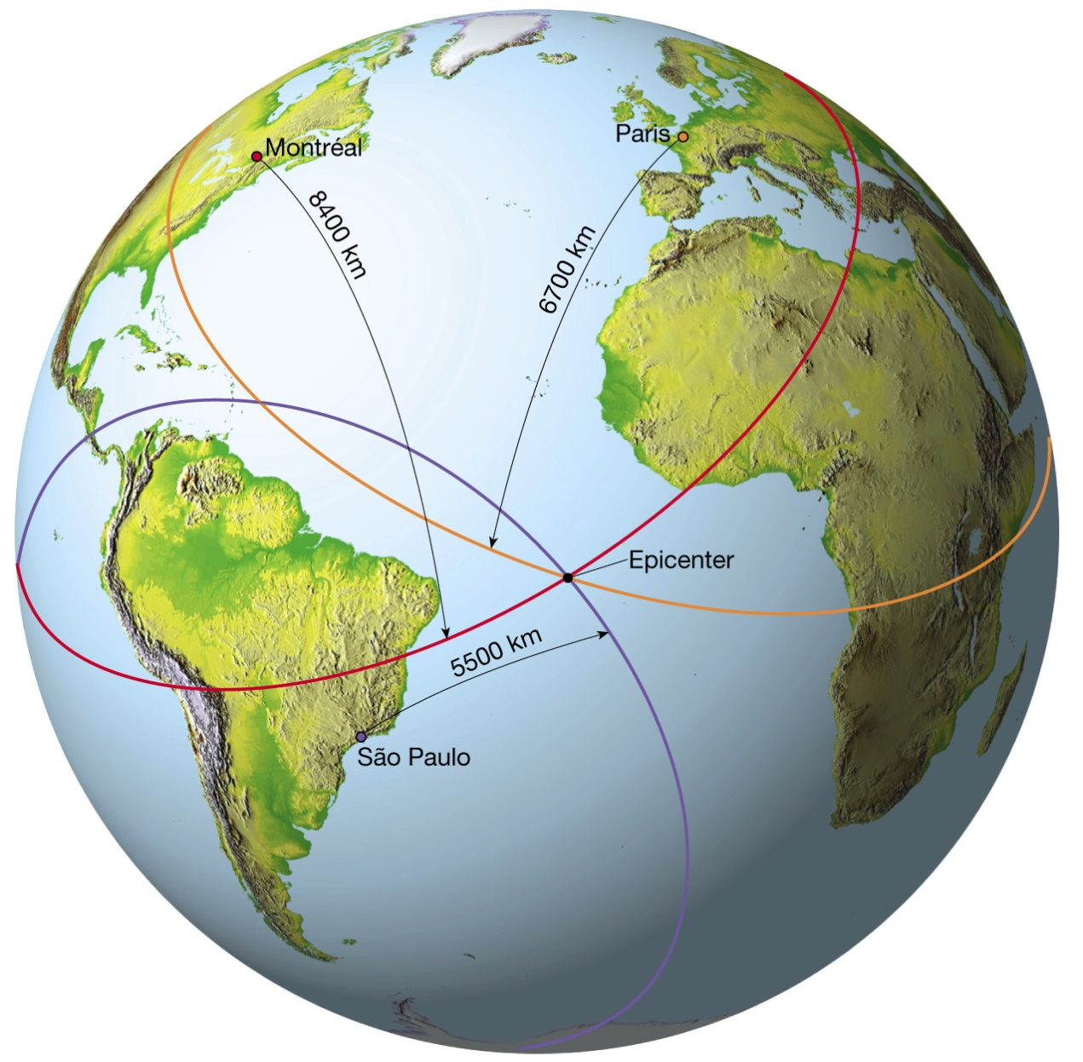
Finding an Earthquake Epicenter
Figure 6.10

Slide 53
Locating an Earthquake
Earthquake belts
About 95 percent of the energy released by earthquakes originates in a few relatively narrow zones that wind around the globe
Major earthquake zones include the Circum-Pacific belt and the Oceanic-Ridge system

Slide 54
Measuring the Size of Earthquakes
Two measurements that describe the size of an earthquake are
Intensity—A measure of the degree of earthquake shaking at a given locale based on the amount of damage
Magnitude—Estimates the amount of energy released at the source of the earthquake

Slide 55
Measuring the Size of Earthquakes
Intensity scales
Modified Mercalli Intensity Scale was developed using California buildings as its standard
The drawback of intensity scales is that destruction may not be a true measure of the earthquake’s actual severity

Slide 56
Measuring the Size of Earthquakes
Magnitude scales
Richter magnitude—Concept introduced by Charles Richter in 1935
Richter scale
Based on the amplitude of the largest seismic wave recorded
Accounts for the decrease in wave amplitude with increased distance

Slide 57
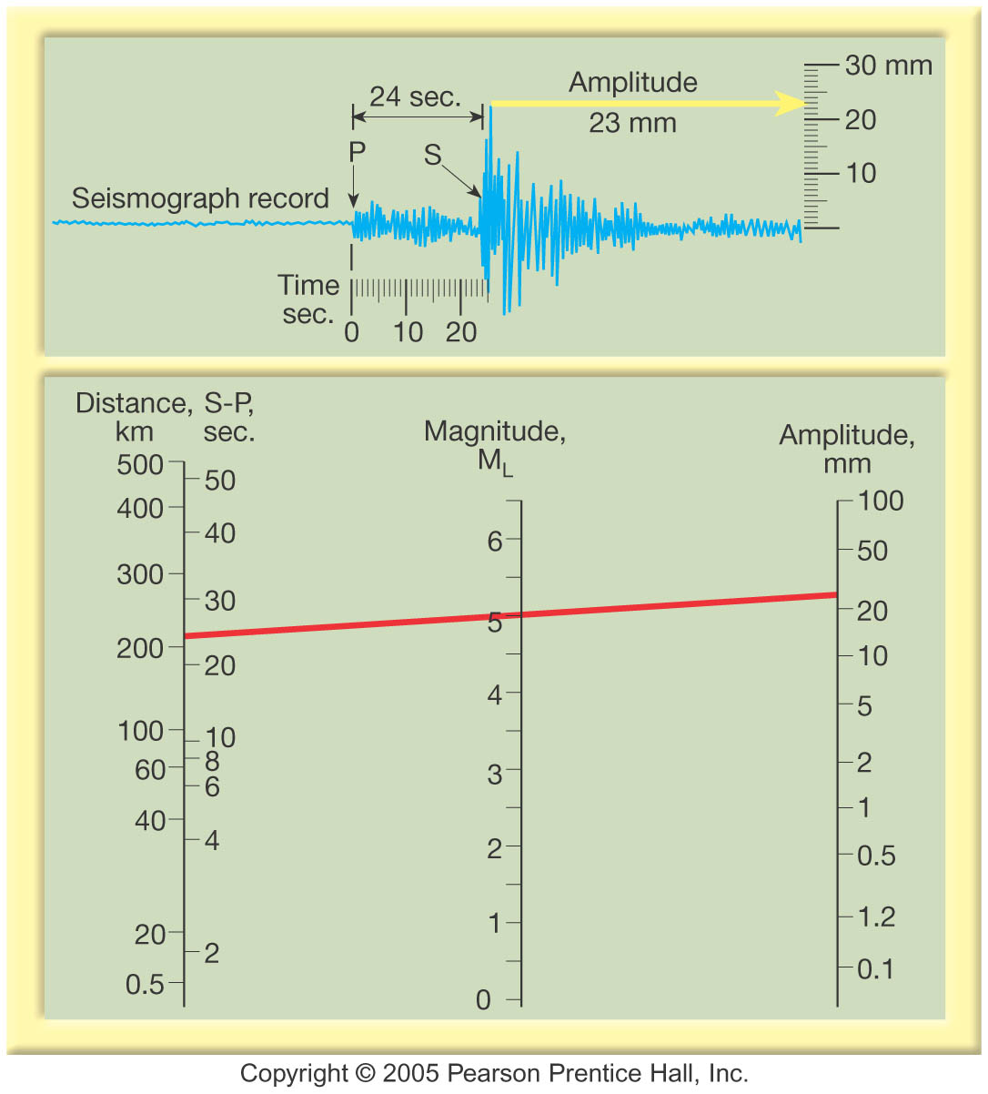
Measuring the Size of Earthquakes
Magnitude scales
Richter scale
Magnitudes less than 2.0 are not felt by humans
Each unit of Richter magnitude increase corresponds to a tenfold increase in wave amplitude and a 32-fold energy increase

Slide 58
Earthquake Destruction
Amount of structural damage attributable to earthquake vibrations depends on
Intensity and duration of the vibrations
Nature of the material upon which the structure rests
Design of the structure

Slide 59
Earthquake Destruction
Amount of destruction depends on
Intensity and duration (magnitude) of the vibrations
Proximity to Population
Nature of the material upon which the structure rests
Design of structures

Slide 60
Earthquake Destruction
Destruction from seismic vibrations
Ground shaking
Regions within 20 to 50 kilometers of the epicenter will experience about the same intensity of ground shaking
However, destruction varies considerably mainly due to the nature of the ground on which the structures are built

Slide 61
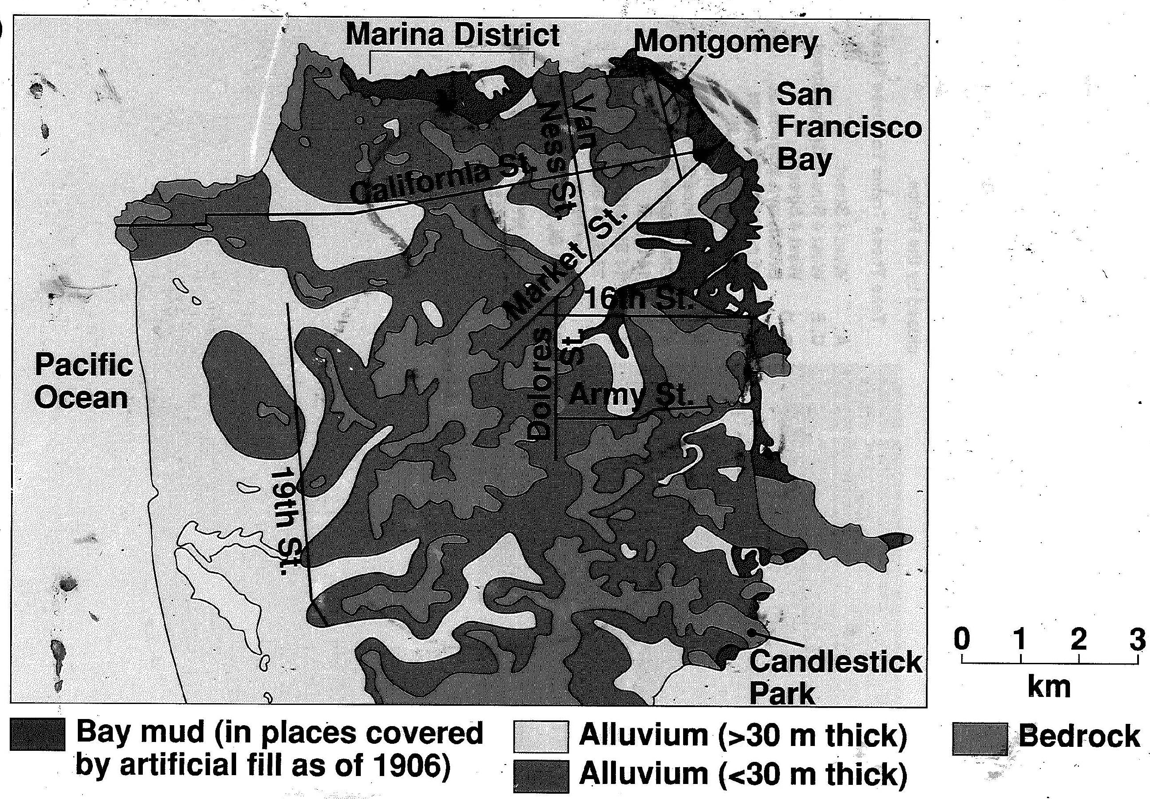
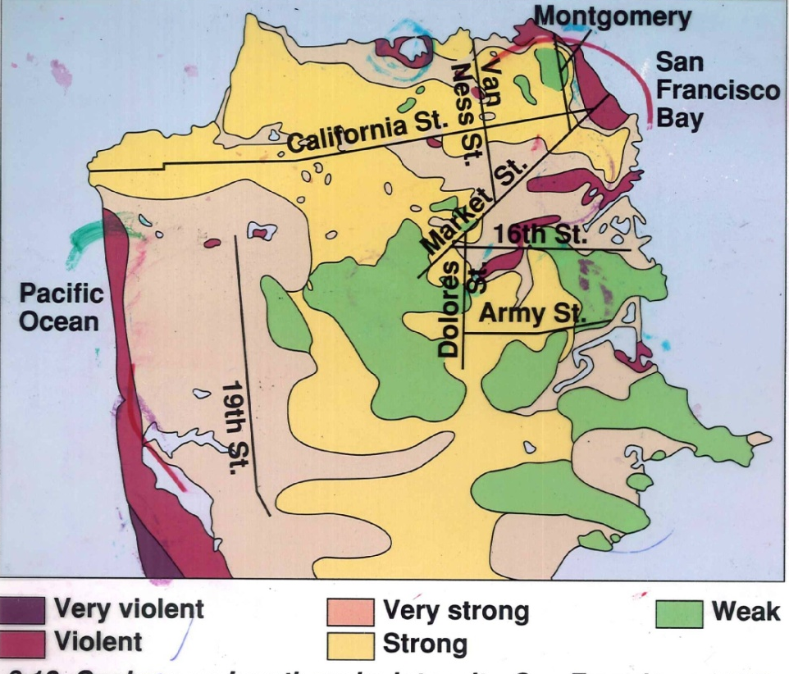
Earthquake Destruction
Liquefaction of the ground - Unconsolidated materials saturated with water turn into a mobile fluid

Slide 62
Earthquake Destruction
Tsunamis, or seismic sea waves
Destructive waves that are often inappropriately called “tidal waves”

Slide 64
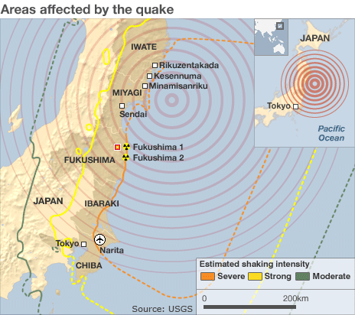
Japan Earth Quake
9.0 magnitude quake (the 4th largest since 1990
Caused when the Pacific tectonic plate subducted under the North American plate
Eastern Japan shifted about 13 feet
shifted the earth's axis by 6.5 inches, shortened day by about 1.6 microseconds
Sank Japan downward by about two feet.

Slide 67
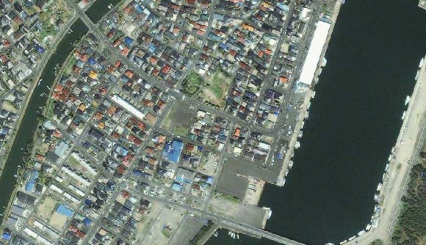

Slide 68
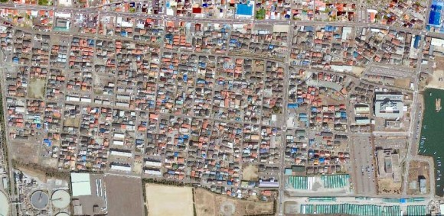

Slide 69
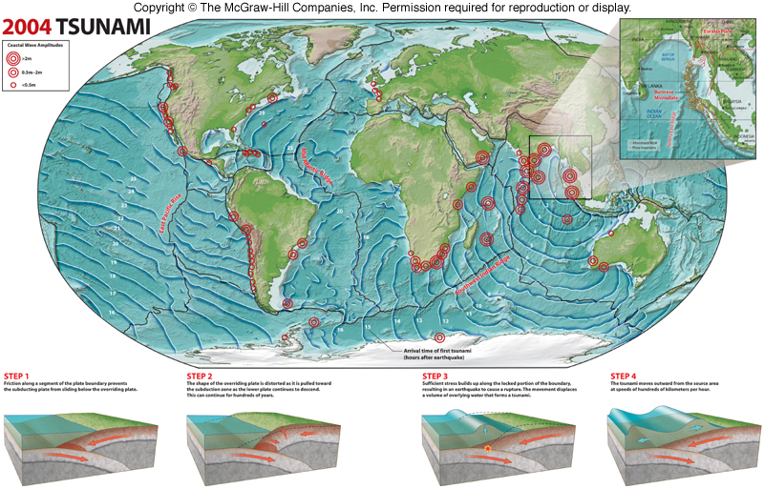
Earthquake Hazards
Tsunami
Fault displacement of ocean floor displaces large volumes of water
Often associated with subduction zones
Fast moving, up to 960 km/hr
Low waves in open ocean but can pile up 10s meters of water along coastline
The Good Earth/Chapter 5: Earthquakes

Slide 70
Earthquake Destruction
Destruction from seismic vibrations
Ground shaking
Regions within 20 to 50 kilometers of the epicenter will experience about the same intensity of ground shaking
However, destruction varies considerably mainly due to the nature of the ground on which the structures are built

Slide 71
Earthquake Destruction
Landslides and ground subsidence
Fire

Slide 72
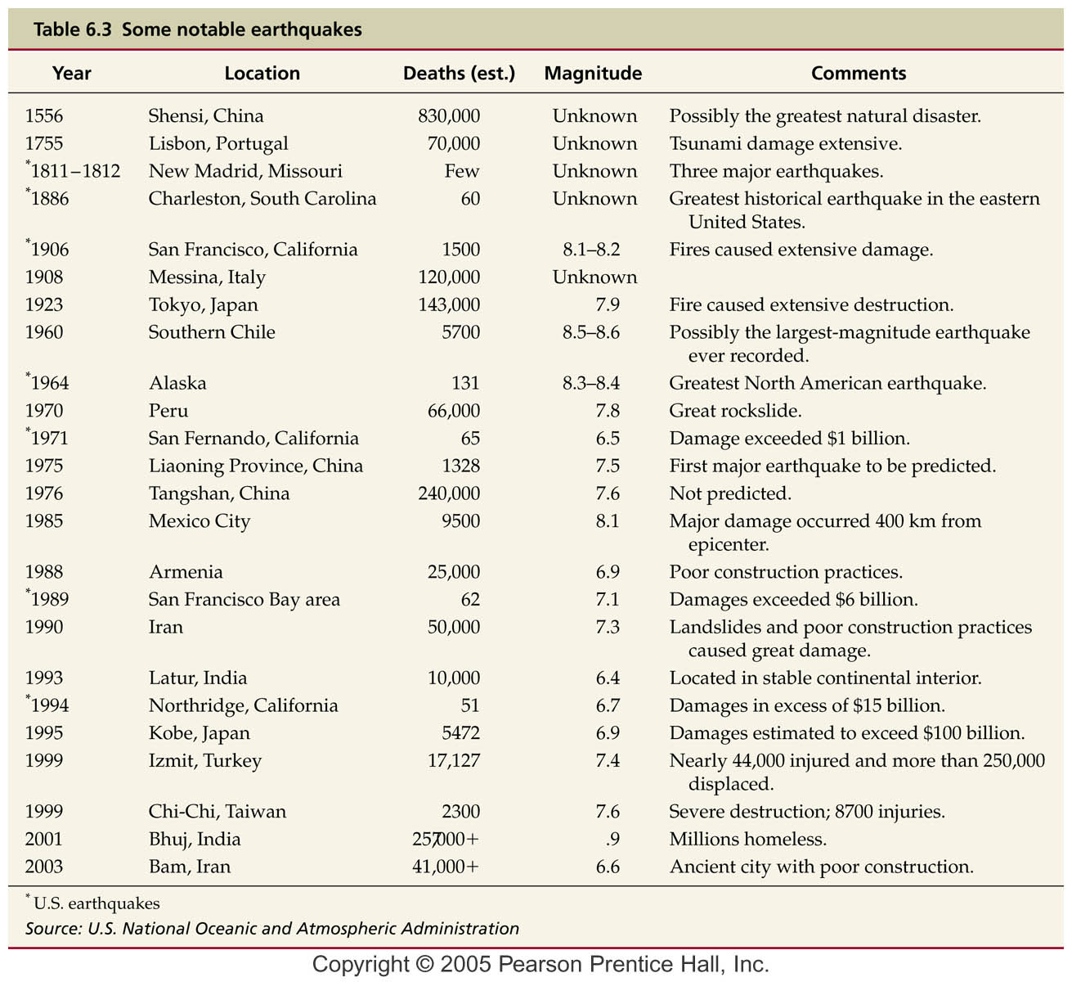
Earthquake Destruction
Population

Slide 73
Earth’s Layered Structure
Layers are defined by composition
Three principal compositional layers
Crust—The comparatively thin outer skin that ranges from 3 km (2 miles) at the oceanic ridges to 70 km (40 miles in some mountain belts)
Mantle—A solid rocky (silica-rich) shell that extends to a depth of about 2900 km (1800 miles)
Core—An iron-rich sphere having a radius of 3486 km (2161 miles)

Slide 74
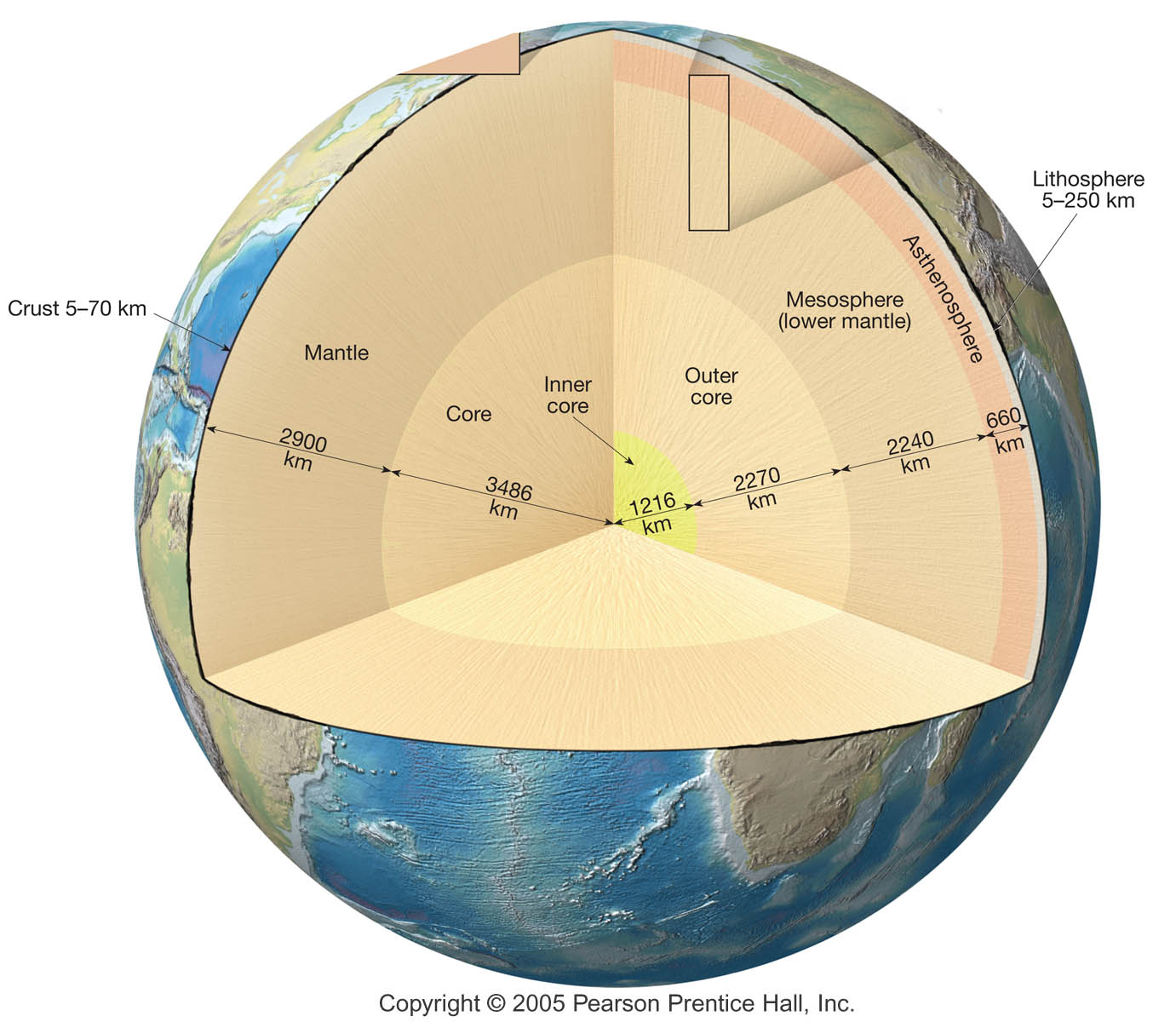
Earth’s Layered Structure

Slide 75
Earth’s Layered Structure
Layers defined by physical properties
With increasing depth, Earth’s interior is characterized by gradual increases in temperature, pressure, and density
Main layers of Earth’s interior are based on physical properties and hence mechanical strength

Slide 76
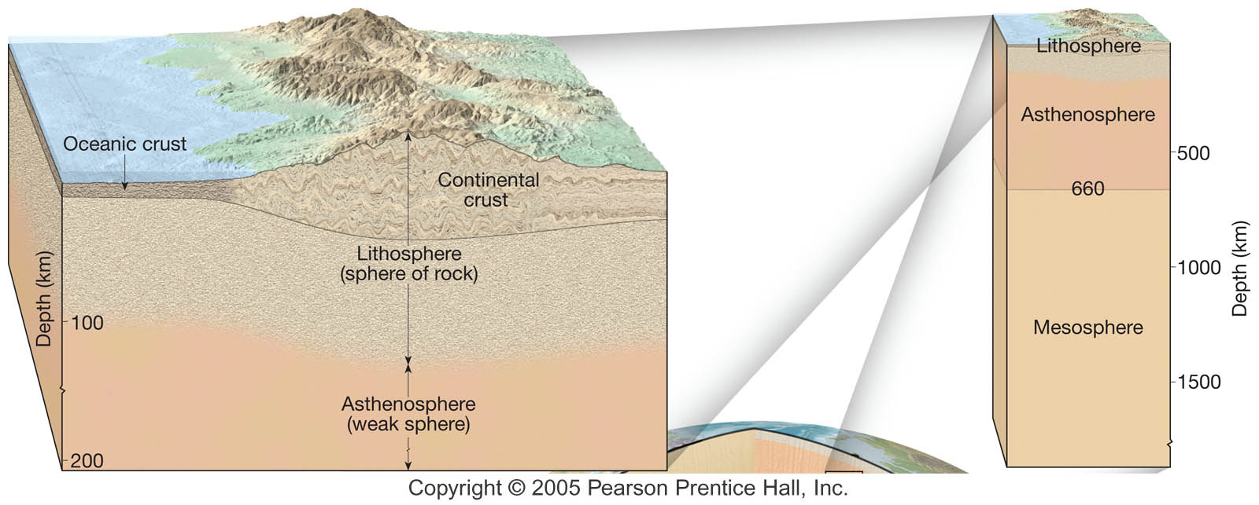
Earth’s Layered Structure
Layers defined by physical properties
Lithosphere (sphere of rock)
Consists of the crust and uppermost mantle
Relatively cool, rigid shell
Averages about 100 km in thickness, but may be 250 km or more thick beneath the older portions of the continents

Slide 77
Earth’s Layered Structure
Layers defined by physical properties
Asthenosphere (weak sphere)
Beneath the lithosphere, in the upper mantle to a depth of about 600 km
Small amount of melting in the upper portion mechanically detaches the lithosphere from the layer below allowing the lithosphere to move independently of the asthenosphere

Slide 78
Earth’s Layered Structure
Layers defined by physical properties
Mesosphere or lower mantle
Rigid layer between the depths of 660 km and 2900 km
Rocks are very hot and capable of very gradual flow

Slide 79
Earth’s Layered Structure
Layers defined by physical properties
Outer core
Composed mostly of an iron-nickel alloy
Liquid layer
2270 km (1410 miles) thick
Convective flow within generates Earth’s magnetic field

Slide 80
Earth’s Layered Structure
Layers defined by physical properties
Inner core
Sphere with a radius of 3486 km (2161 miles)
Stronger than the outer core
Behaves like a solid

Slide 81
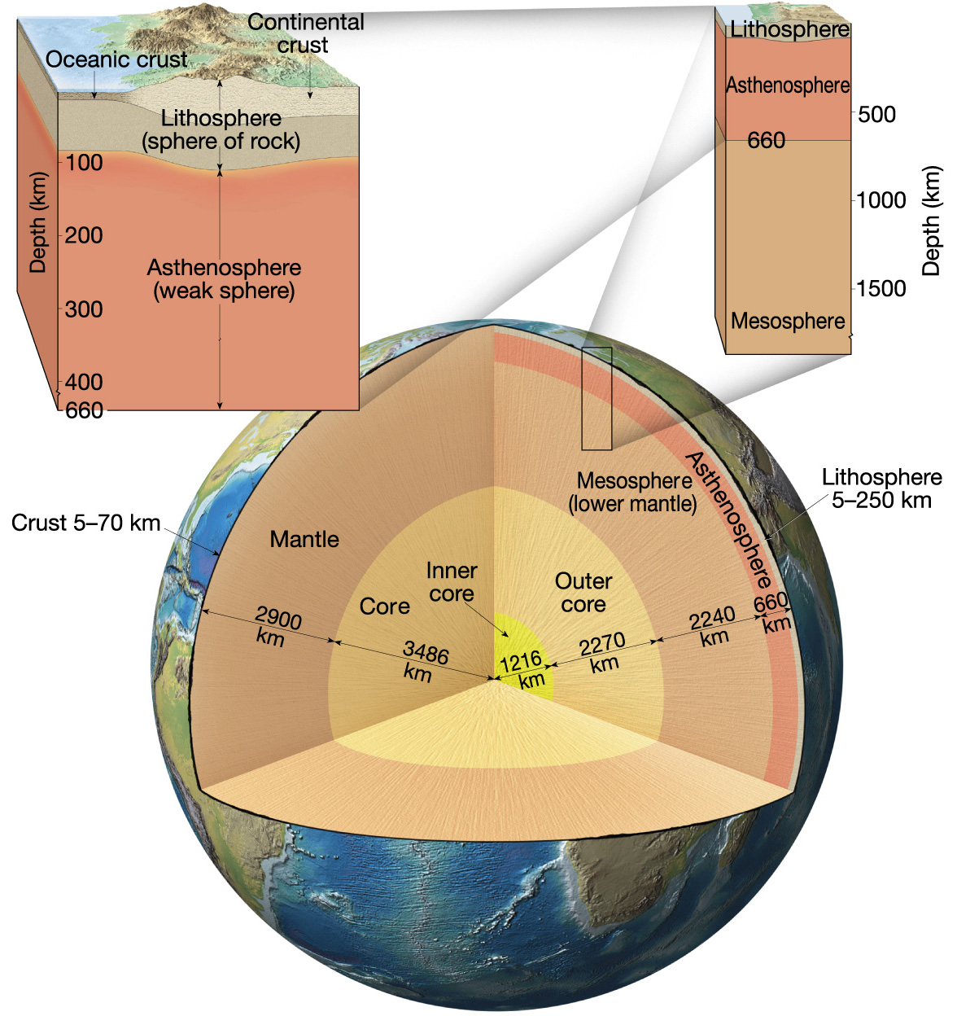
Earth’s
Layered
Structure

Slide 82
Earth’s Layered Structure
Determination of the Earth Inner Structure
No drilling through the crust
All knowledge of the earths interior comes from observation of earthquake waves

Slide 83
Earth’s Layered Structure
Earthquake waves travel at different speeds
Change direction as they move through materials of density
S waves can’t travel through liquids

Slide 84
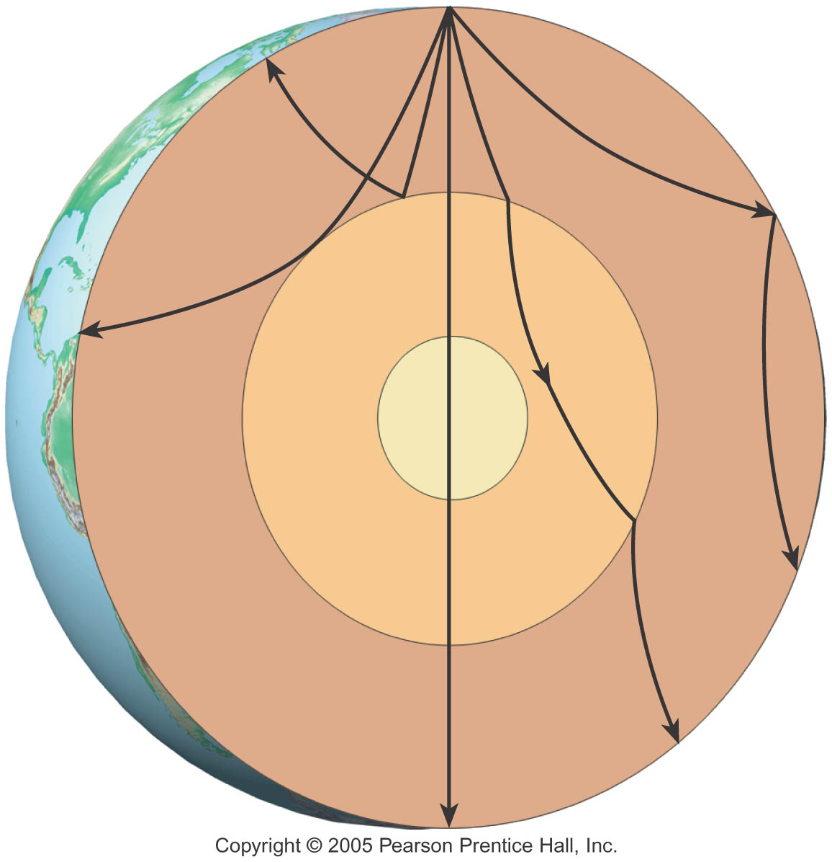
Earth’s Layered Structure
P – Wave Shadow Zone

Slide 85
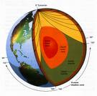
Earth’s Layered Structure
S – Wave Shadow Zone

Slide 86
Earth’s Layered Structure
Mohorovivic (Moho) Zone
Boundary between crust and mantle

Slide 87
Geologic Structures
Deformation is a general term that refers to all changes in the original form and/or size of a rock body
Most crustal deformation occurs along plate margins

Slide 88
Geologic Structures
Folds and Faults
Folds – anticlines and synclines
Faults – Dip Slip faults and Thrust Faults

Slide 89
Folds
During crustal deformation rocks are often bent into a series of wave-like undulations called folds
Characteristics of folds
Most folds result from compressional stresses which shorten and thicken the crust

Slide 90
Folds
Common types of folds
Anticline—Upfolded or arched rock layers
Syncline—Downfolds or troughs of rock layers
Depending on their orientation, anticlines and synclines can be described as
Symmetrical, asymmetrical, or recumbent (an overturned fold)

Slide 91
Geologic Structures
Folds – anticlines and synclines

Slide 92
Folding
Notes:
To view this animation, click “View” and then “Slide Show” on the top navigation bar.

Slide 93
Folds
Other types of folds
Dome
Upwarped displacement of rocks
Circular or slightly elongated structure
Oldest rocks in center, younger rocks on the flanks

Slide 94
Folds
Other types of folds
Basin
Circular or slightly elongated structure
Downwarped displacement of rocks
Youngest rocks are found near the center, oldest rocks on the flanks

Slide 95
Faults
Faults are fractures in rocks along which appreciable displacement has taken place
Sudden movements along faults are the cause of most earthquakes

Slide 96
Faults
Types of faults
Dip-slip faults
Movement is mainly parallel to the dip of the fault surface
May produce long, low cliffs called fault scarps
Parts of a dip-slip fault include the hanging wall (rock surface above the fault) and the footwall (rock surface below the fault)

Slide 97
Faults
Types of dip-slip faults
Normal fault
Hanging wall block moves down relative to the footwall block
Accommodates lengthening or extension of the crust
Larger scale normal faults are associated with structures called fault-block mountains

Slide 98
Faults
Types of dip-slip faults
Reverse and thrust faults
Hanging wall block moves up relative to the footwall block
Reverse faults have dips greater than 45º and thrust faults have dips less than 45º
Strong compressional forces

Slide 99
Normal Fault
Reverse Fault

Slide 100
Faults
Notes:
To view this animation, click “View” and then “Slide Show” on the top navigation bar.

Slide 101
Faults
Strike-slip fault
Dominant displacement is horizontal and parallel to the strike of the fault
Types of strike-slip faults
Right-lateral—As you face the fault, the opposite side of the fault moves to the right
Left-lateral—As you face the fault, the opposite side of the fault moves to the left

Slide 102
Faults
Strike-slip fault
Transform fault
Large strike-slip fault that cuts through the lithosphere
Accommodates motion between two large crustal plates

Slide 103
Strike-Slip fault
Figure 6.24 D

Slide 104
The San
Andreas
Fault
System
Figure 6.26

Slide 105
Mountain Building
Orogenesis—The processes that collectively produce a mountain belt
Include folding, thrust faulting, metamorphism, and igneous activity
Compressional forces producing folding and thrust faulting
Metamorphism
Igneous activity

Slide 106
Oceanic-Continental Convergence

Slide 107
Continental-Continental Convergence

Slide 108
Collision and
Accretion of an
Island Arc
Figure 6.32

Slide 109
Accretion

Slide 110
Terrane Formation
Notes:
To view this animation, click “View” and then “Slide Show” on the top navigation bar.

Slide 111
End of Chapter 6 Next Week 2nd test Chapters 4, 5, and 6

